Slide 1
LGBTI RIGHTS, the long road.
Gloria Careaga
Fundación Arcoiris

Slide 2
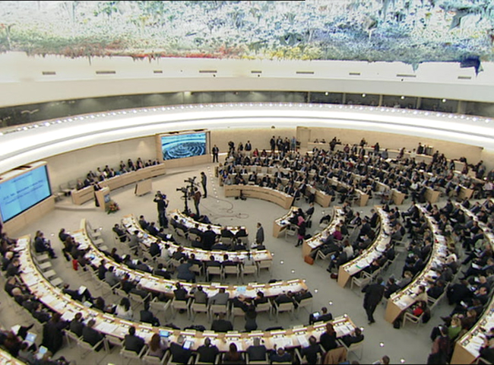
International agreements
Beijing
UNHRC
UNGASS

Slide 3
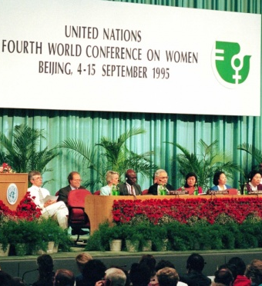
UN WORK and Strategizing
Sexual rights
Health
Abortion
Sexual orientation
Citizenship
Labor-work

Slide 4
Achievements
Deep discussion
Aware on SSRR
Sexual orientation in the agenda

Slide 5
Beyond beijing
Moral Panic
Geopolitical panorama
Religions
Sexuality on the agenda
LGBT rights

Slide 6
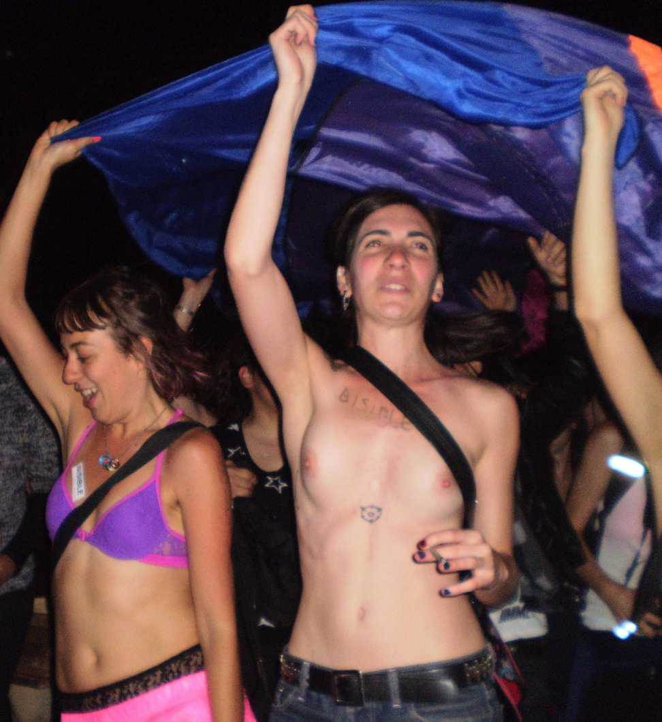
Sexual Rights
Feminist Initiatives
Challenges
Rape
Harassment
Child abuse
Sexual work
Trafficking
Etc, etc, etcss.

Slide 7
Sexual orientation
UN Statement
UPR evaluation
Legal Reforms
Marriage; Against discriminatory laws; Labor-work; Political participation; HIV
Wide Visibility
Persecution-Sanction
Criminalization

Slide 8
challenges
Sexual Rights
Decriminalization
Broader view
Sociocultural Change
UN agreements

