Slide 2
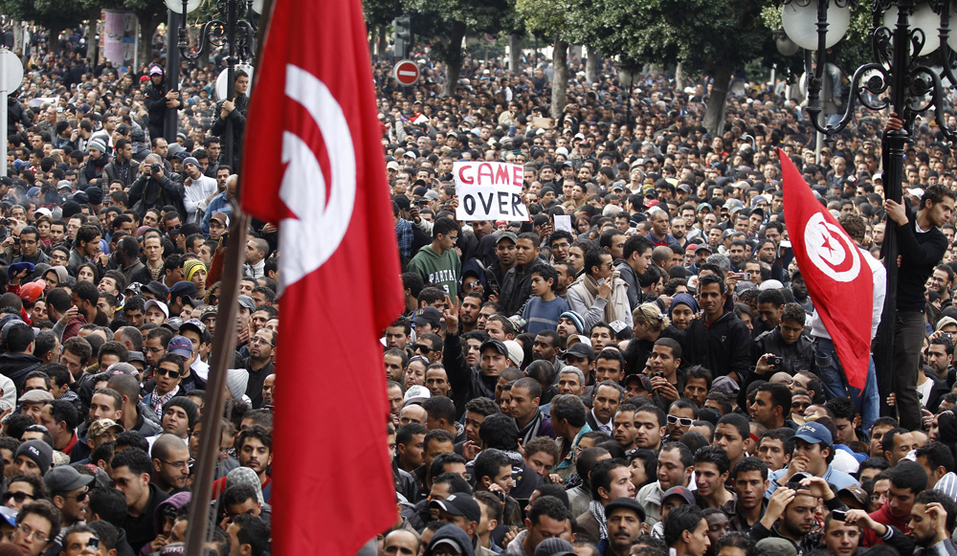
Tunisia

Slide 3
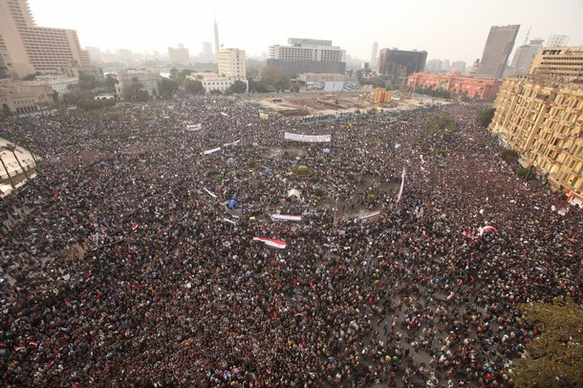
Egypt

Slide 4
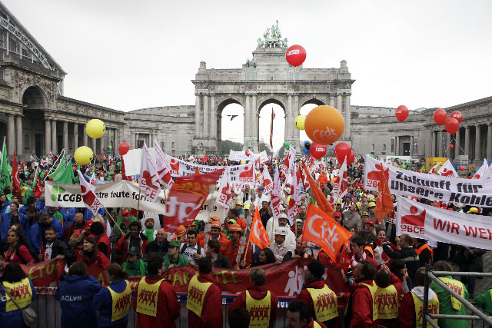
Across Europe

Slide 5
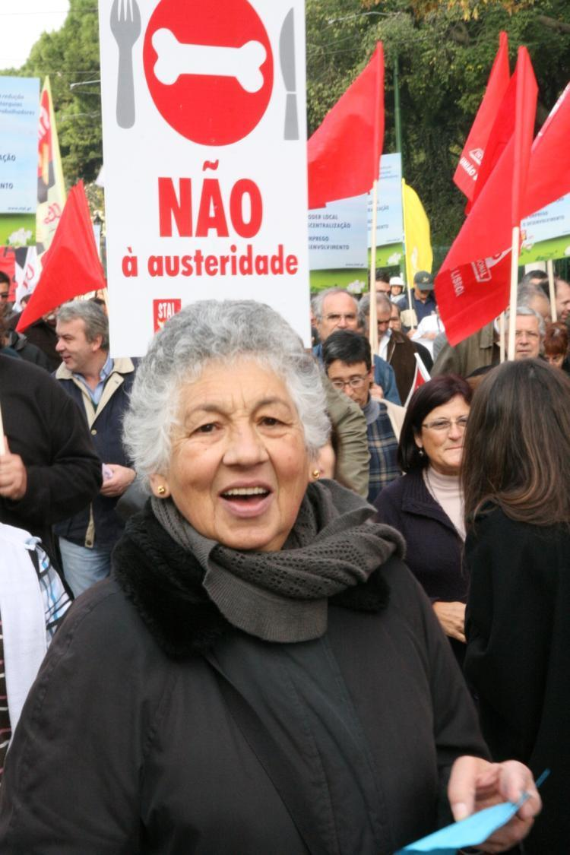
Portugal

Slide 6
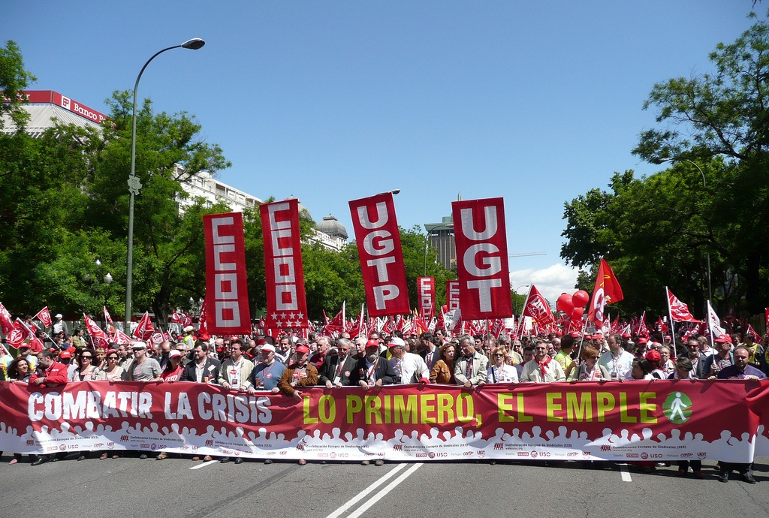
Spain

Slide 7
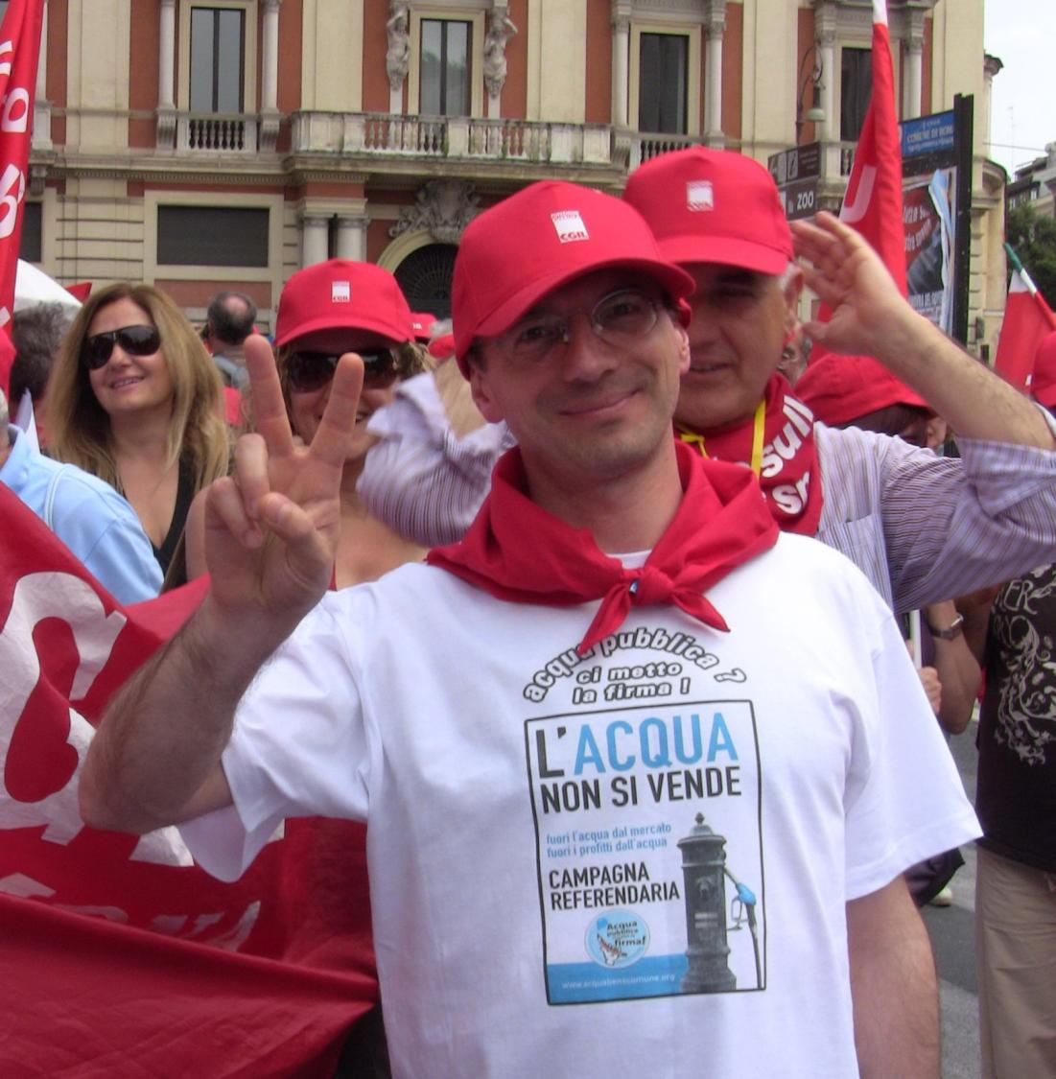
Italy

Slide 8
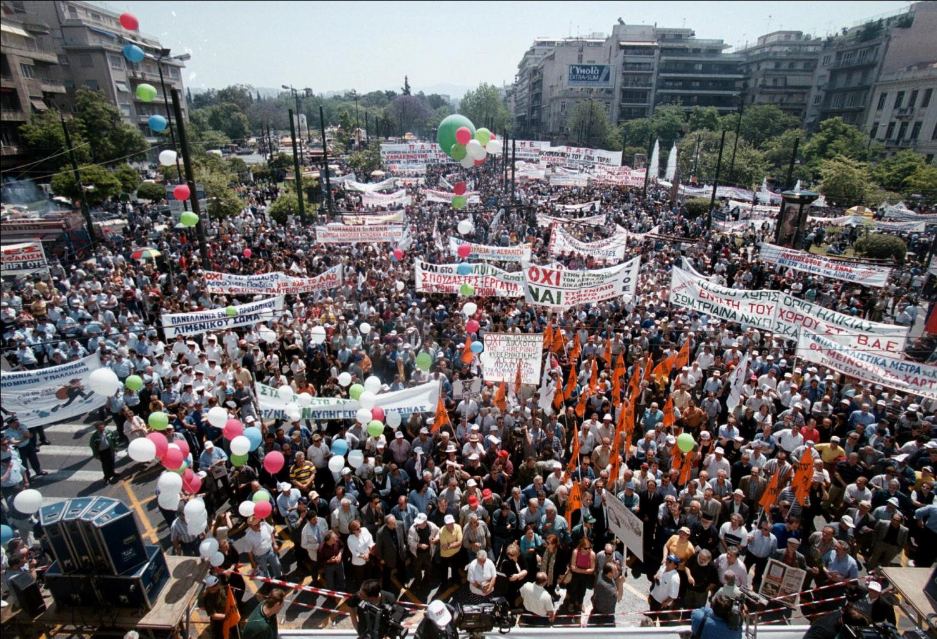
Greece

Slide 9
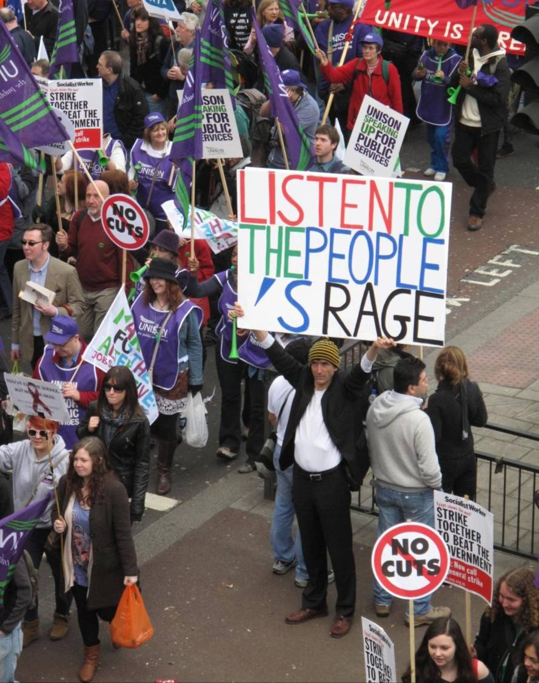
London

Slide 10
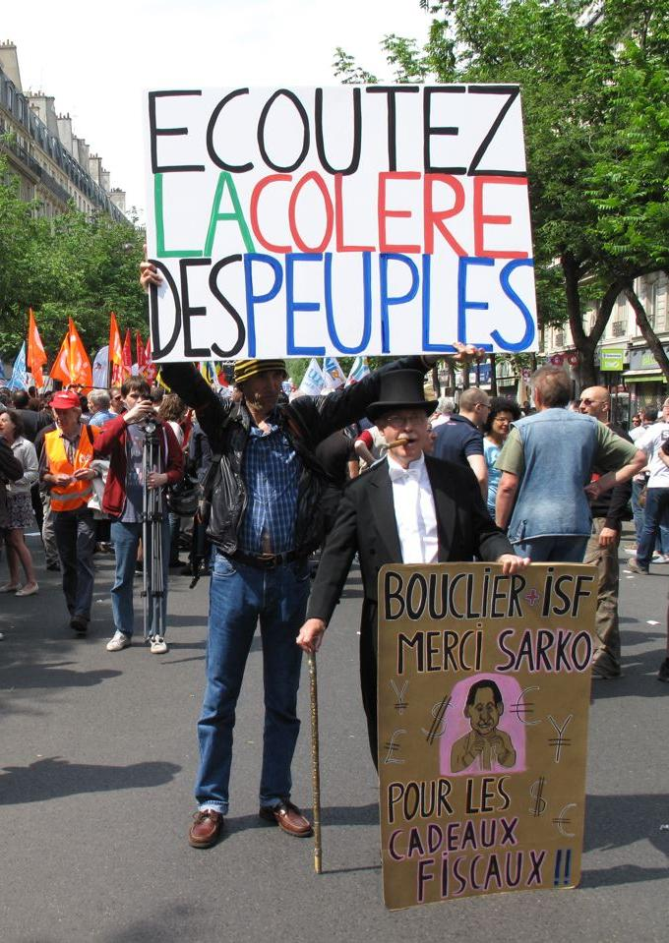
Paris

Slide 11
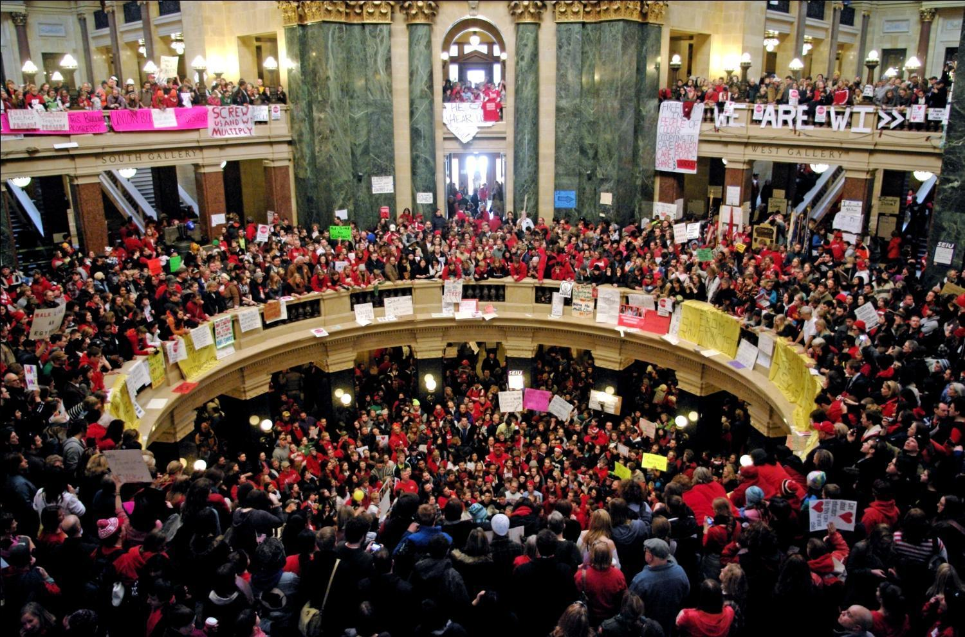
Wisconsin

Slide 12
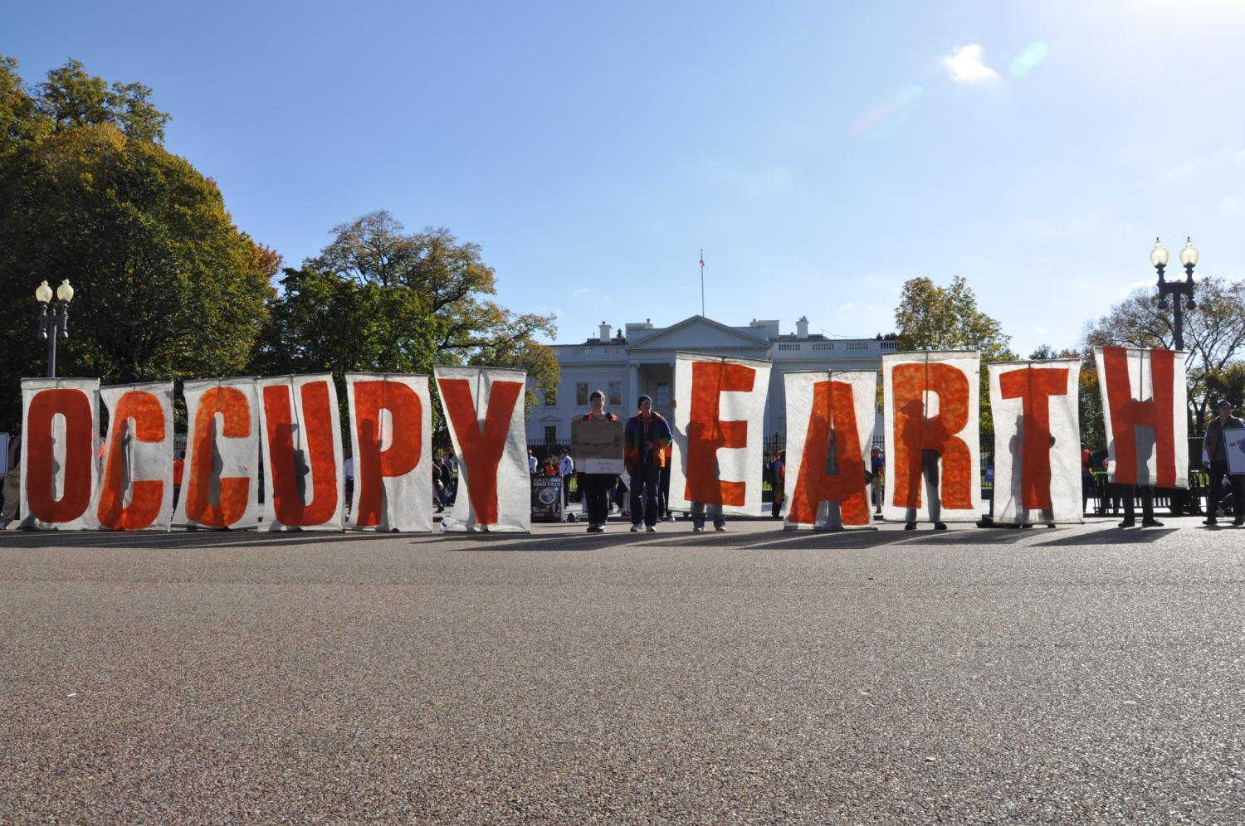

Slide 13
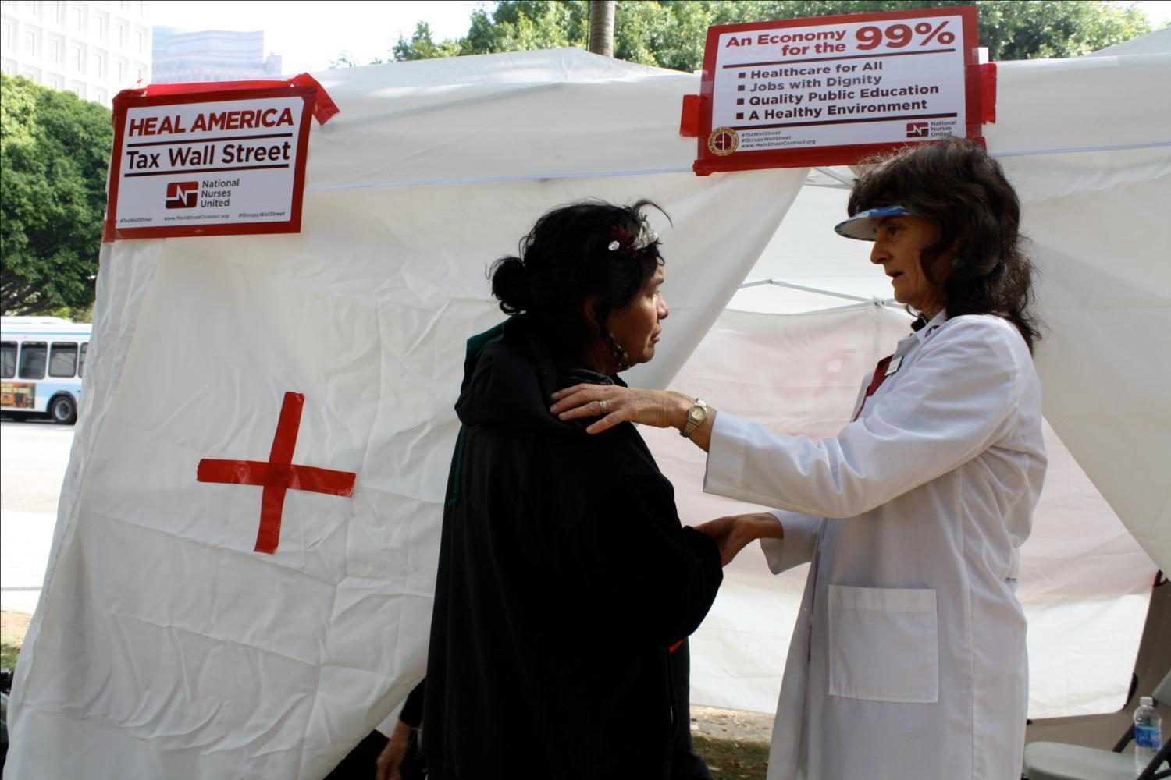
Occupy LA

Slide 14
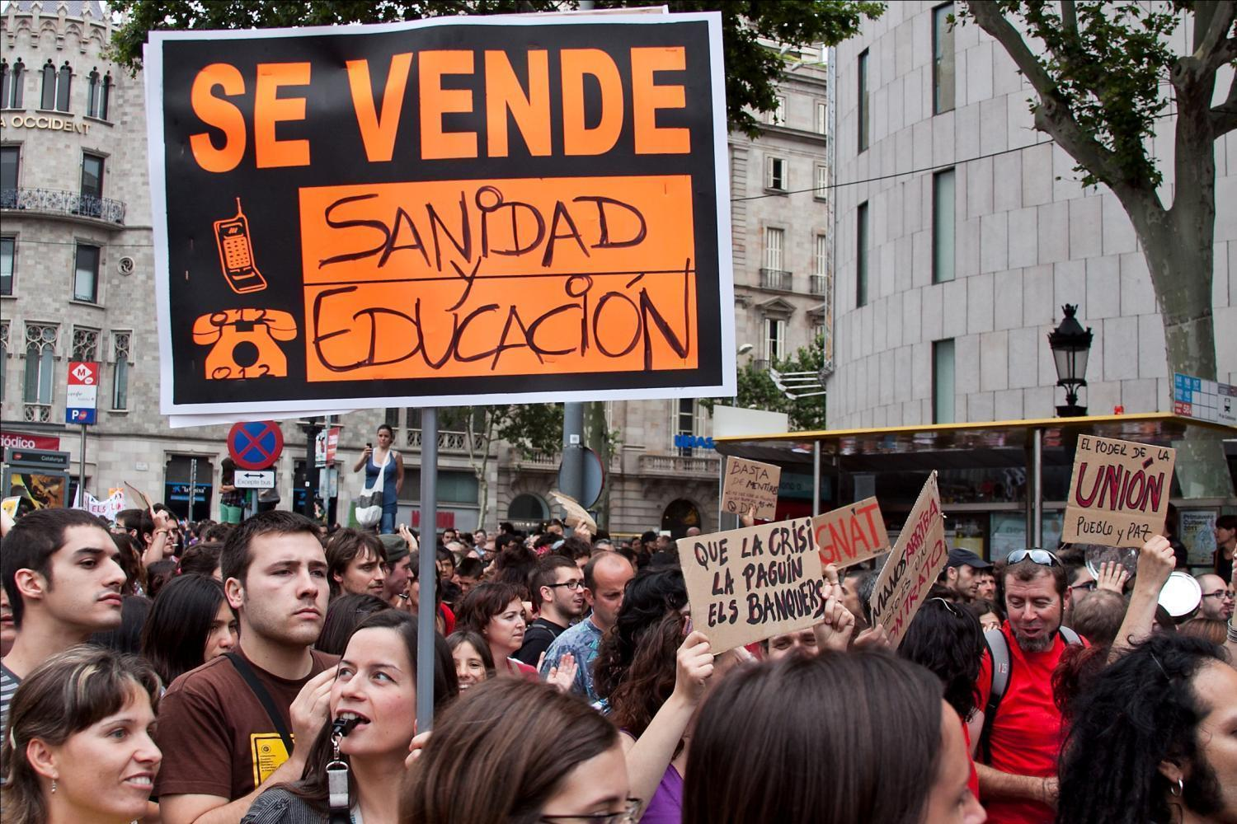
Indignados

Slide 15
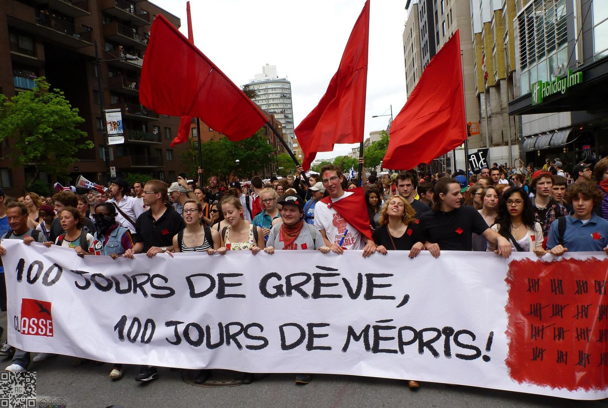
Quebec students

Slide 16
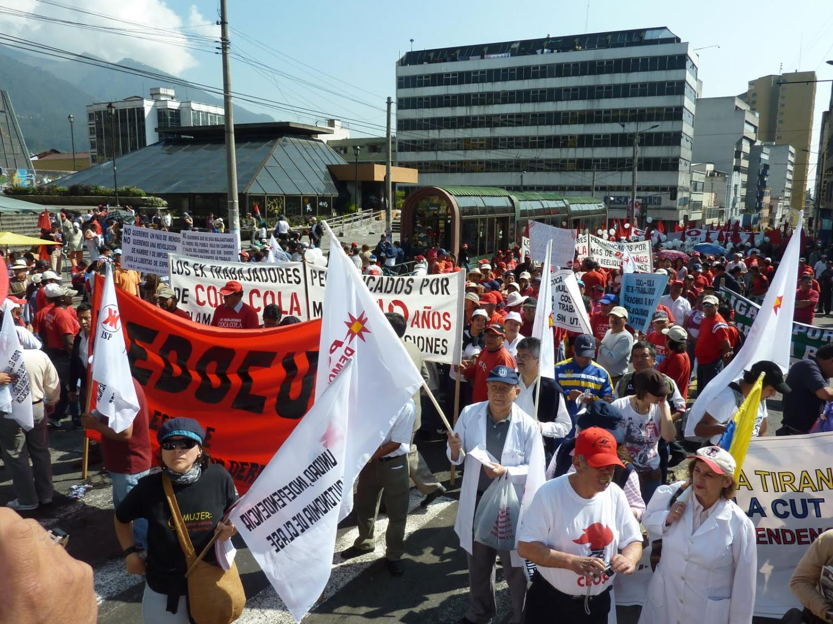
Ecuador

Slide 17
Global forces of neoliberalism that undermine the
common good require globalized forms of resistance and alternate solutions.

Slide 18
Financial transactions tax
(Robin Hood Tax) and tax justice campaigns are not about endorsing current capitalist system, but are means to curb speculation and redistribute wealth from
the 1% to the 99%.

Slide 19
Robin Hood Tax (FTT)
If applied globally, a financial transactions tax at a rate of .01%
could raise over USD $1 trillion per year,
or 2% of global GDP.

Slide 20
There’s class warfare, all right, but it’s
my class, the rich class, that’s making war, and we’re winning.
-Warren Buffet (world’s third wealthiest person in 2011)

Slide 21
The great tax robbery
Many companies paying
less than half the tax rates
they paid in 1960s and 1970s.

Slide 22
Giant corporations that have basically stopped paying taxes
General Electric; Boeing; Exxon Mobil; Verizon; Kraft Foods; Citigroup; Dow Chemical; IBM; FedEx; Honeywell; Apple; Pfizer; Google; Microsoft; Merck

Slide 23
Loss for the common good
Tax Justice Network estimated that assets held offshore, beyond the reach of effective taxation, are equal to about a third of total global assets, about $21 trillion - $32 trillion.
Over half of all world trade passes through tax havens.

Slide 24
Impact of cuts on tax collection/fraud
Denmark - 28.7% cuts in staffing - losing tax revenue
UK – 19.2% By cutting more than 3300 staff, loss of £1.1 bn in potential tax revenue. (Data sale)
NL- 6.3% Reduce budget for tax and customs by 17% by 2015. Chance of a business being audited is once in every 43 years.
*EPSU study

Slide 25
Pivotal moment for economic justice
South and North understand “economic colonization”
Community anger at austerity
Widespread anger at inequality
Anger at corporations for not paying fair share
Media exposés (tax havens, corporate tax dodgers such as Google, Starbucks, Apple…)
Global FTT and tax justice coalitions

Slide 26
PSI + Council of Global Unions
20 million members, healthcare, education, water and sanitation, direct govt, tax inspectors, auditors, customs…
CGU 200 million members in private & public, agricultural, construction, mining, energy, finance …
PSI leads CGU QPS campaign working group
Working in coalition in global tax justice campaign
National affiliates engaging at country level with TJN partners…

Slide 27
Loose international coalition
Fluid, non-hierarchical
Centre on common messages (values)
Participatory but non-binding processes
Regular international teleconference or skype calls (free)
Annual one-day strategy meeting
People propose and take responsibility for different tasks (research, advocacy, event planning etc)
Power of diversity
Link local, national, international efforts

Slide 28
Common messages
A financial transactions tax to end poverty and inequality through funding public services, sustainable development, and addressing climate change.
Tax justice for a fair share for all

Slide 29
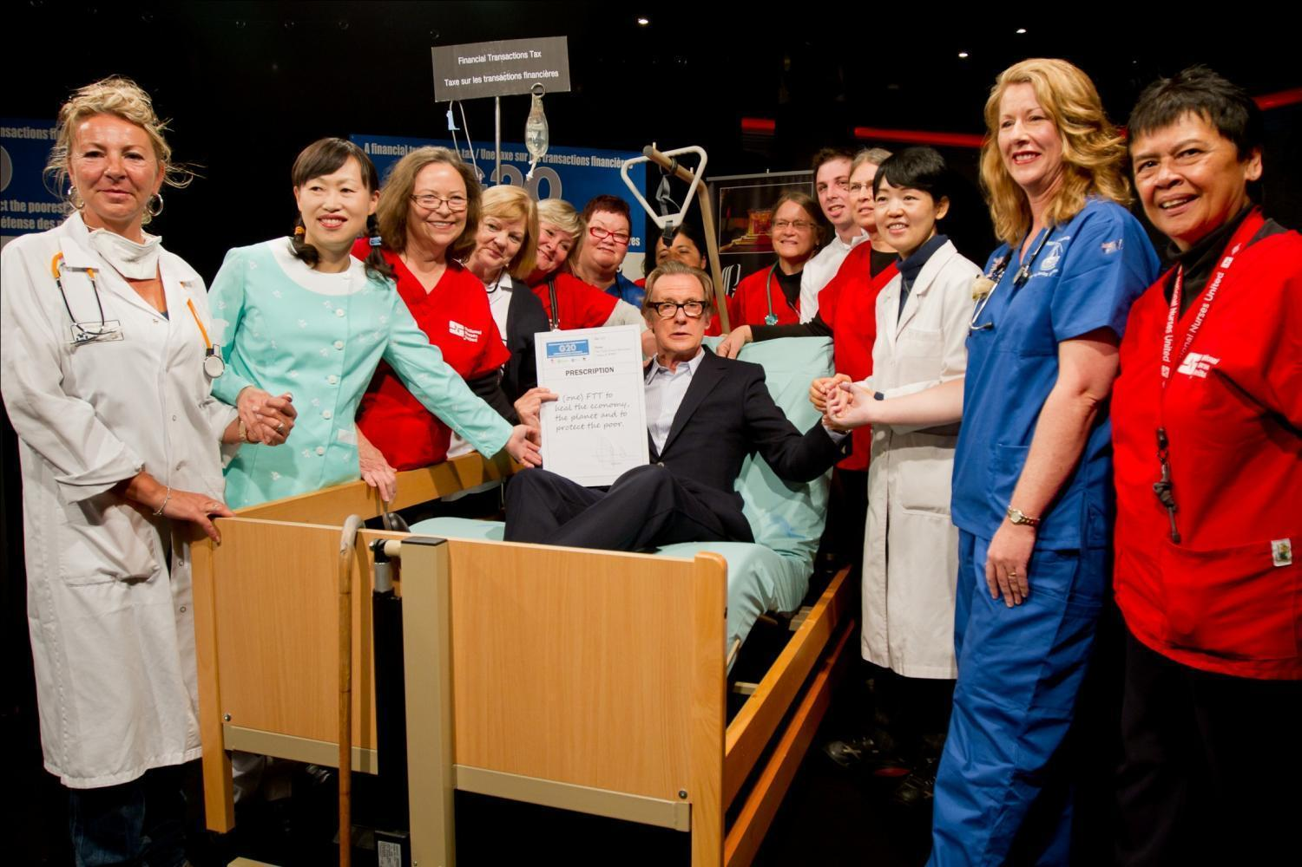
G20 – Cannes

Slide 30
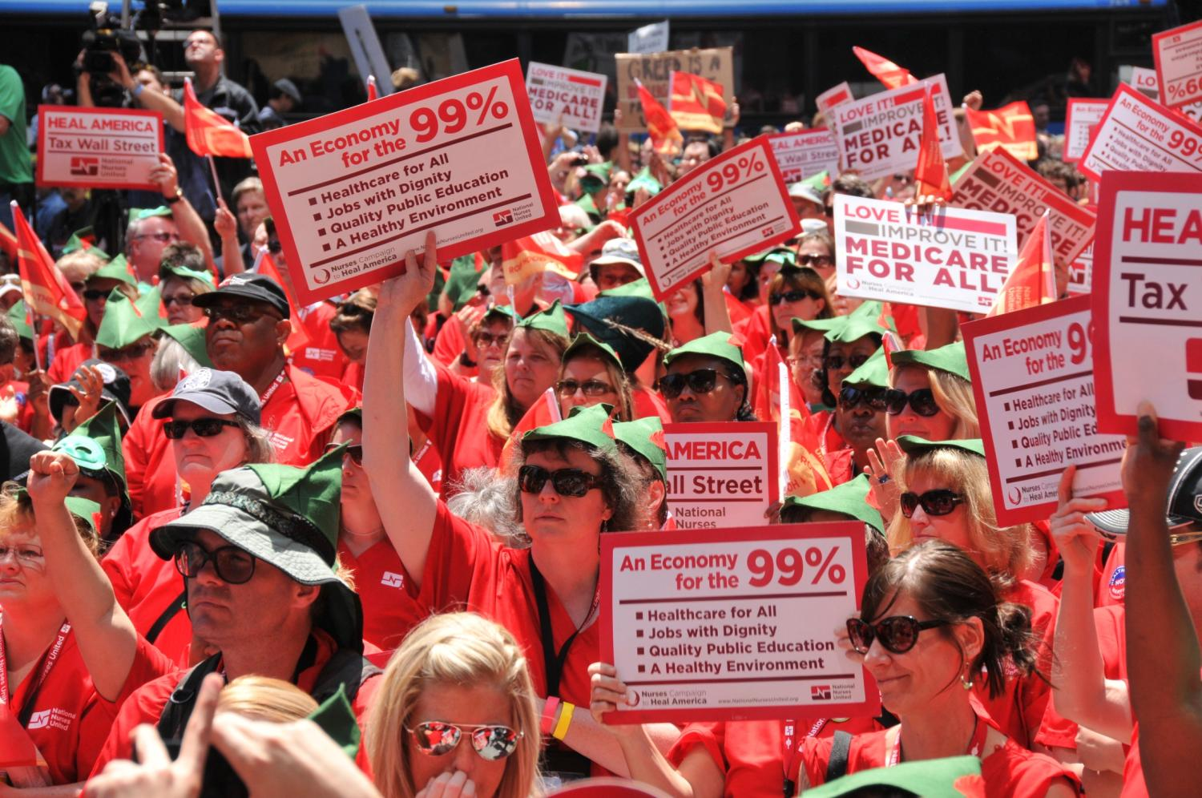
G8 – Chicago

Slide 32
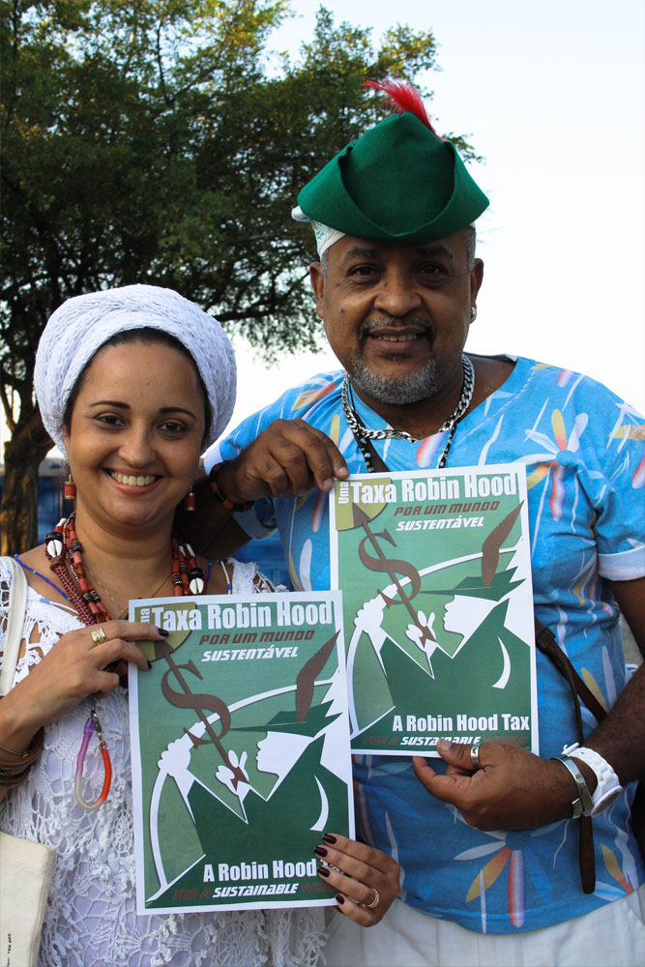

Slide 33
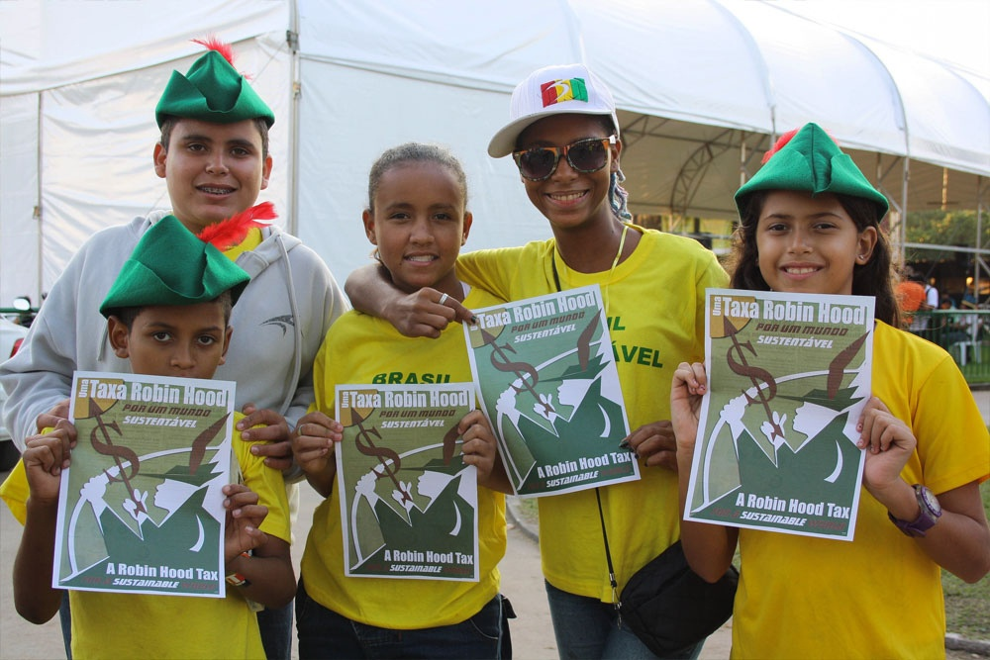

Slide 34
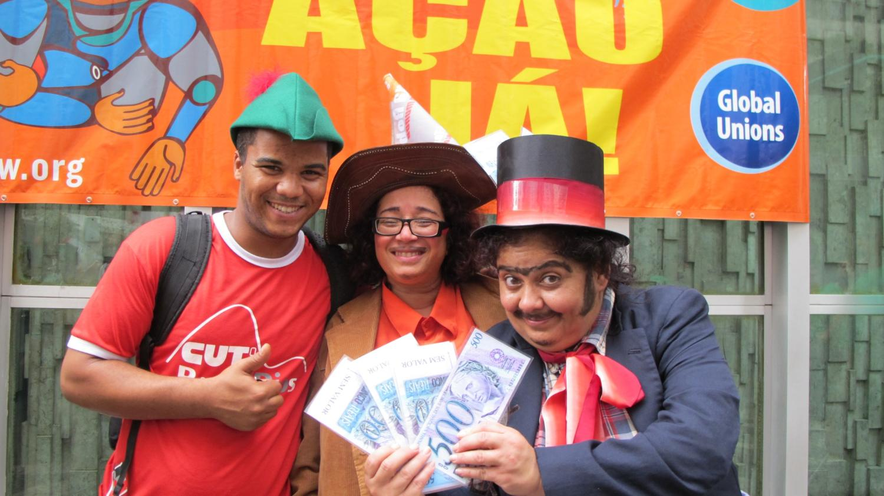
Rio+20 Earth Summit

Slide 36
Rio+20 rally

Slide 37
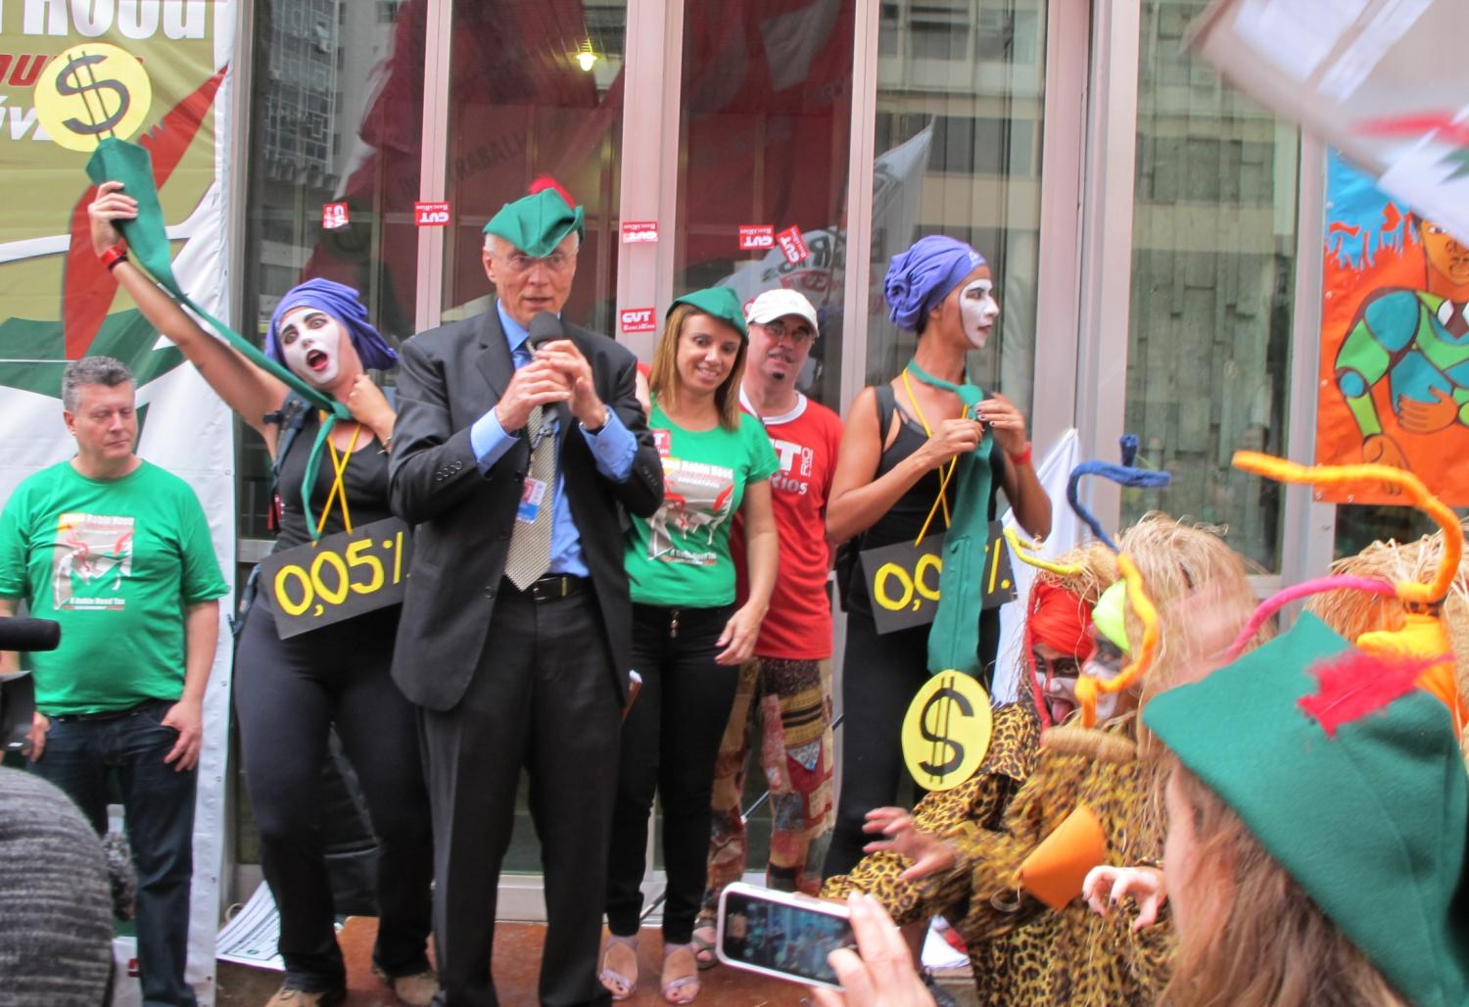

Slide 38
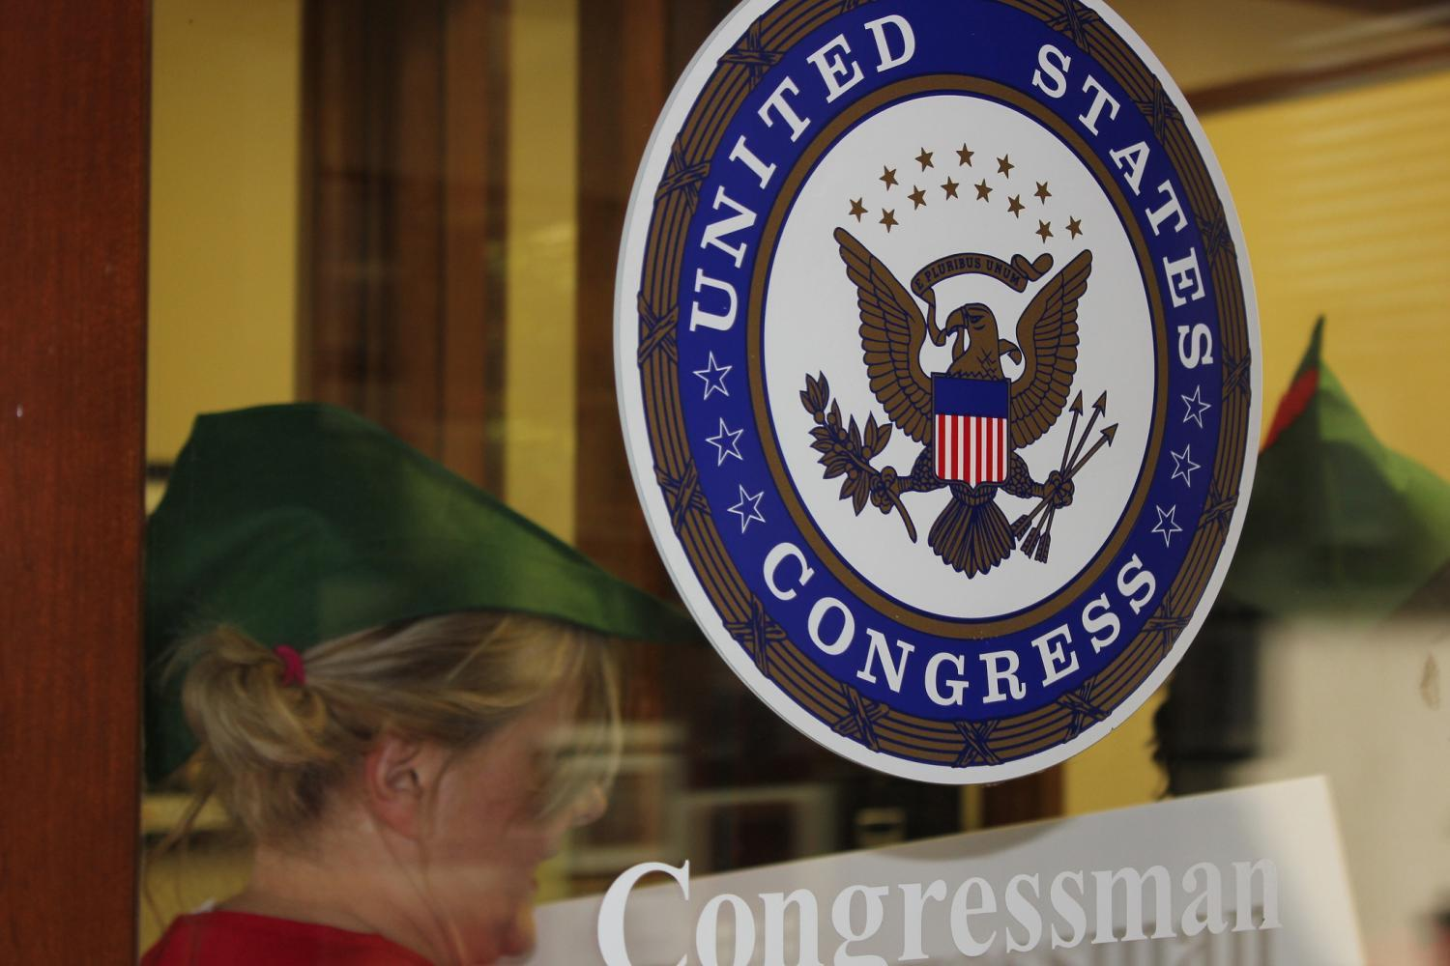
Robin Hood Tax USA launch

Slide 39
European Union
FTT / Robin Hood Tax
11 = Austria, Belgium, Estonia, France, Germany, Greece, Italy, Portugal, Slovenia, Slovakia, Spain
+ possibles - Czech Republic and Croatia

Slide 40
Estimated that FTT will raise €34 billion annually
across the 11 EU countries

Slide 42
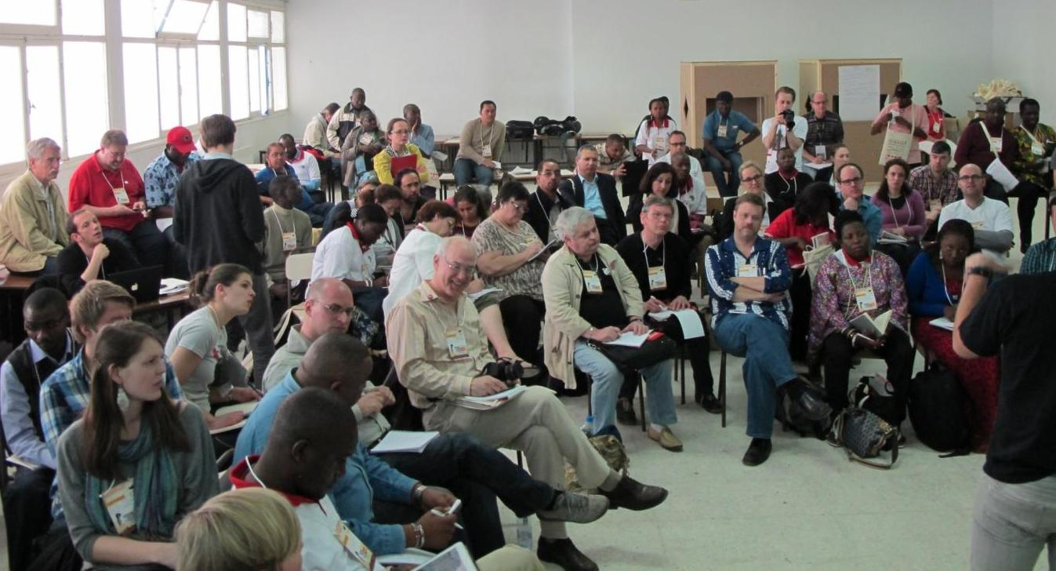
The World Needs Tax Justice & an FTT

Slide 43
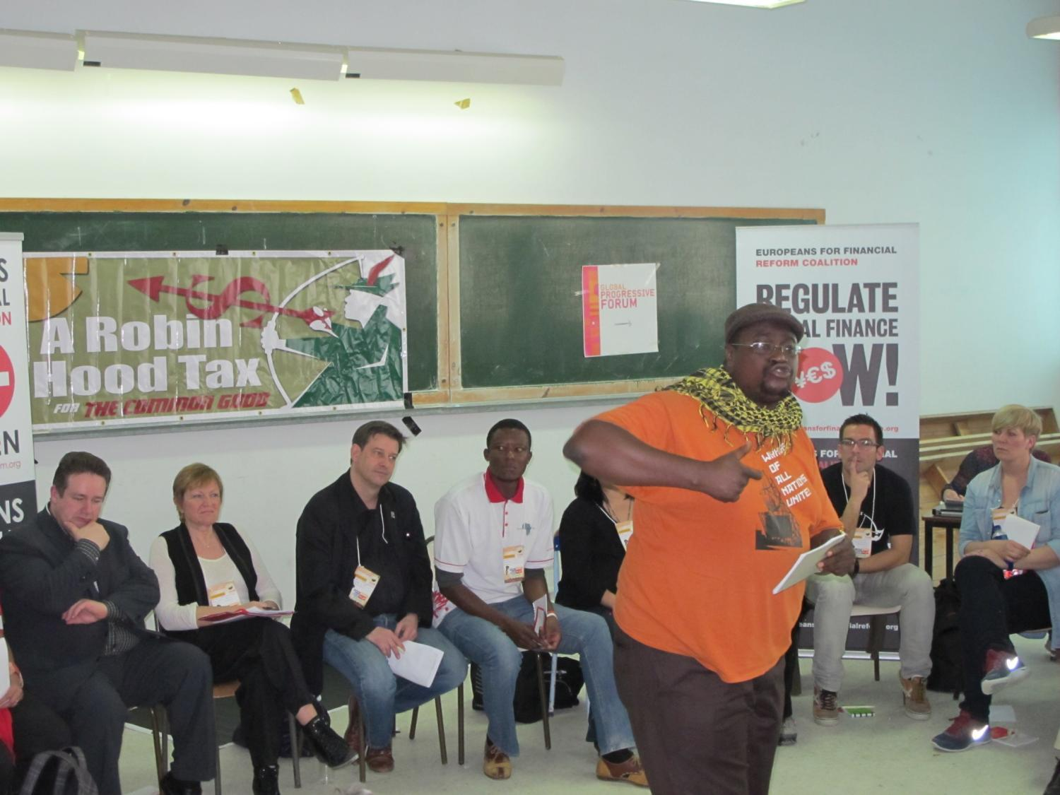

Slide 46
Taxation and Quality Public Services
Financing of quality public services depends on a progressive taxation system: higher income groups
pay more tax than lower
Effective government tax authority requires:
well-paid tax inspectors and enough staff
a lack of corruption
transparency of personal and corporate financial information.

Slide 47
Opportunities
Strengthen profile, recruit & mobilize affiliates to build national campaigns with allies
Provide training and strategic support to launch pilot campaigns in four PSI regions
Identify union messaging, research, materials required
Connect with CORRUPTION and TRADE issues

Slide 48
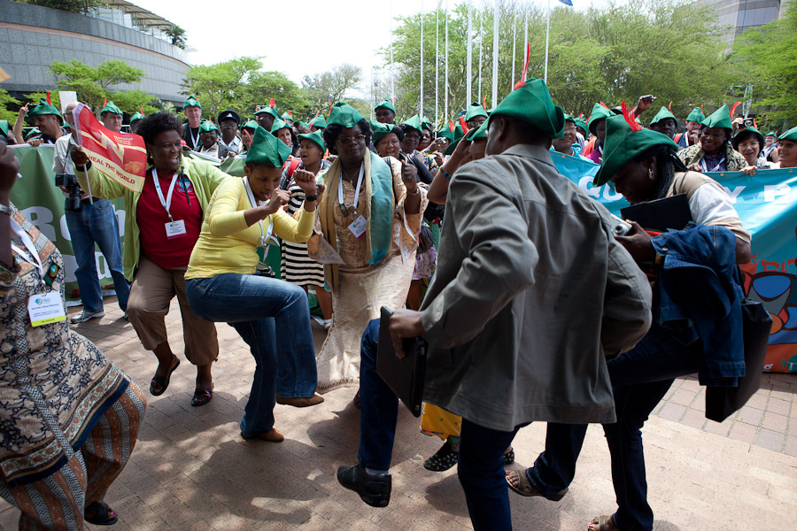
PSI World Congress, SA

Slide 49
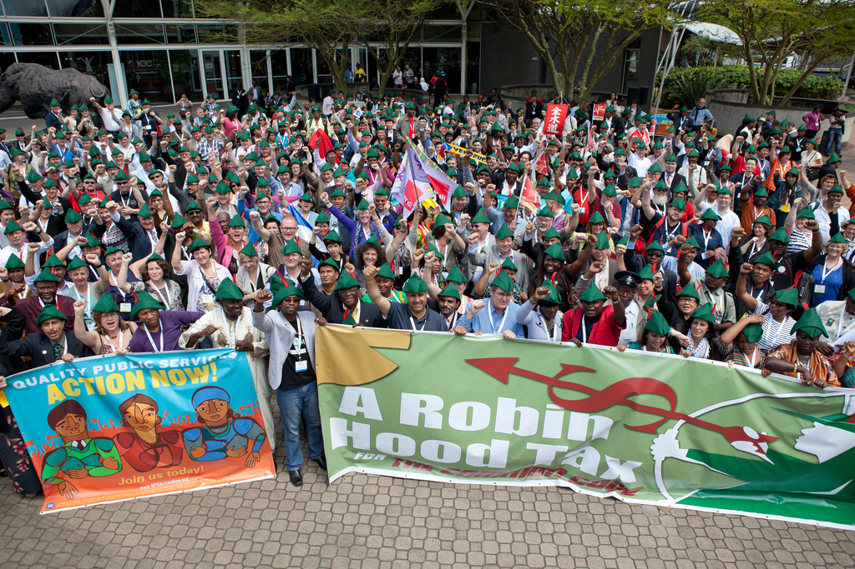
1000 Robin Hoods

Slide 50
Our messages
Tax justice for quality public services
Tax justice to end corruption
Tax justice to end poverty and inequality
Tax justice for a fair share for all

