Slide 1
PSI Caribbean’s perspectives and experiences in the fight against Corruption and for Tax Justice
Presented by Roland Ignacio, ABVO Curaçao
PSI-FES Project Workshop
Santiago de Chile
7 – 8 October, 2014

Slide 2
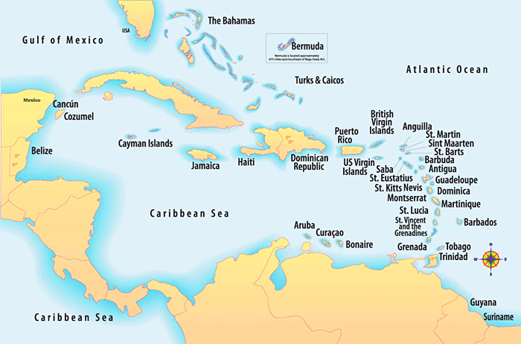

Slide 3
About the sub-region
24 affiliates in 20 countries and territories
Population
5,000 Montserrat | 10,000 – 30,000 Caribbean Netherlands Anguilla | 30,000 – 50,000 Sint Maarten, Turks & Caicos Islands, British Virgin Islands
50,000 – 100,000 St Vincent & the Grenadines, Antigua &Barbuda, Dominica, Cayman Islands, St Kitts-Nevis | 100,000 – 200,000 Curaçao, Grenada, St Lucia, Aruba, US Virgin Islands | 200,000 – 500,000 Guadeloupe, Martinique, Bahamas, Barbados,
500,000 – 1 million Suriname and Guyana | 1.3 million Trinidad & Tobago | 2.7 million Jamaica
10.7 million Haïti

Slide 4
Multiple languages (French, Dutch, English, Papiamento, Haitian Creole, Spanish)
Government – parliamentary democracies and republics, including
Independent countries
British and French Overseas Territories
Countries in the Kingdom of the Netherlands
Economies
Small, open
Highly vulnerable to external shocks
‘Natural’ disasters and other climate change factors are major threats to growth and sustainability

Slide 5
Representation of workers in the (sub)sectors
All affiliates (except CTSP Haiti) represent workers in:
Border control and protection (Customs and Immigration)
Inland Revenue and other revenue collecting agencies (land tax, licensing, corporate registries, etc)
Audit Departments
Ministries and departments responsible for public procurement
Legal affairs, including lawyers and judges
Some also represent workers in Police and Coast Guard
Montserrat CSA
WICSU-PSU in Sint Maarten *
ABVO Curaçao *
* Note the responsibilities of the Kingdom for Defence

Slide 6
Gender and age composition
50%+ women in all the (sub)sectors; in some countries, as high as 60% are women
Increasing numbers of young women (under 35 years) in Immigration and Customs
35 years and over in other departments, especially at senior levels

Slide 7
Successes, challenges
General salary and wage bargaining across the public sector – applied to all workers
Conditions of service negotiated separately
Public sector unions are generally included in national consultations
Transition to Revenue Authorities under which all revenue collecting agencies are now grouped
Stated intention is to improve collections especially from companies and self-employed professionals (doctors, lawyers, contractors, consultants, etc)
New systems of work including new technologies
Introduction of finger-printing of staff (especially in Guyana; reason given is for time-keeping)
Staff shortages

Slide 8
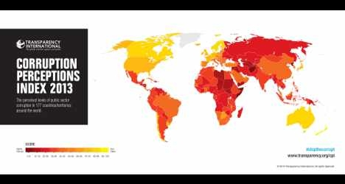
Fight against corruption
2013 perceptions Index of corruption in public sector of Transparency International
Jamaica and T&T, 38
Suriname, 36
Guyana, 27
Haïti, 19
Other Caribbean countries score above 50
Notes:
Index shows peoples perceptions of corruption in the public sector.

Slide 9
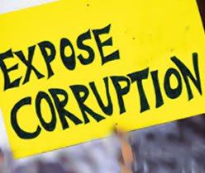
Current concerns
Guyana and Trinidad & Tobago
Corruption also linked to race and ethnic relations and tensions
In T&T, unions fighting against contract nature of judges in the Industrial Court. Situation results in postponement of cases, delays in judgments
Recent charges about expenditure for building works not properly completed or on time
Guyana has not passed anti-money-laundering bill and has been “blacklisted” by Caribbean Financial Action Taskforce (CFATF)
Jamaica
Most recent case relates to public procurement and charges made by the Contractor General regarding multimillion dollar building projects
Haiti
Long history of various forms of corruption linked to absence of living wages and partisan political pressures especially in relation to public procurement
St Maarten and Curacao
Recent report highlighting problems related to border control and protection, money laundering drug- and human-trafficking
Suriname
Long history at highest levels of government linked to arms-trading and drug-trafficking

Slide 10
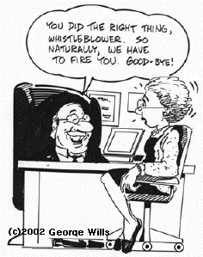
Big challenges for unions and workers
Small countries and communities
Fear of victimization
Partisan politics
No whistleblower protection
Unions generally have no clear guidelines or policies on corruption in the public sector and have not trained activists on the issue

Slide 11
Some important questions
How to identify target countries for action and campaign?
What are the key criteria?
What will be the specific role for unions and activists?
Who will be our partners?

Slide 12
Tax justice is one aspect of the on-going conversation on high debt, growth and sustainability of Caribbean economies
And there are obvious links with anti-corruption activities and campaign

Slide 13
Importance of taxation in the Caribbean
3 main sources of revenue
taxation of capital, including physical capital and financial capital
taxation of labour
taxation on consumption
Caribbean countries were always heavily dependent on taxes from customs duties (especially Antigua & Barbuda, Bahamas, Bermuda)
With liberalization of trade, this revenue declined substantially
Taxation on income and profits has become important in resource-based economies (e.g. Trinidad & Tobago)
In service-based countries there is an increase in taxation of goods and services (introduction of VAT in a number of economies
VAT and sales taxes have been introduced to make up for shortfall in revenue from customs duties

Slide 14
Tax policies across the Caribbean
Include combinations of:
Personal income tax
Corporate income tax
Consumption tax
Property tax
Taxation of small taxpayers
Import tariffs

Slide 15
Income Tax
Varied income tax regimes throughout the sub-region
Some countries do not levy taxes on personal income (Bahamas, Cayman Islands, Bermuda, St Kitts-Nevis)
Antigua & Barbuda, Grenada recently re-introduced income taxes
Others levy taxes depending on residency status
In some there are flat rates (Belize, Jamaica – 25%)
In others rates vary according to income levels

Slide 16
Value Added Tax (VAT) revenue
Introduced in a number of countries to replace revenue lost from customs and import duties
Bahamas will soon introduce VAT
 | Rate (%) | % of GDP
Barbados | 17.5 | 10
Trinidad % Tobago | 15 | 6
Jamaica | 16.5 | 8
Haïti | 10 | 4

Slide 17
Total tax revenue as % of GDP
Suriname | 32
Trinidad & Tobago | 29
Barbados | 27
Curaçao | 26
Dominica | 24
Jamaica, Belize | 23
St Vincent & the Grenadines, Guyana, Anguilla | 22
St Lucia, St Kitts-Nevis | 21
Grenada, Antigua & Barbuda, Sint Maarten | 18
Bahamas | 16
Haiti | 13

Slide 18
Tax havens
Characteristics of tax havens
Nil or only nominal taxes on individuals or businesses.
Protection of personal financial information.
Lack of transparency.
Cayman Islands is the key player in the Caribbean in terms of secrecy and global impact and are (ranked at 4)
Cayman Islands and other Caribbean countries are on the gray list
There is a potential new PSI affiliate in the Cayman Islands
http://www.financialsecrecyindex.com/introduction/fsi-2013-results

Slide 19
Tax havens in the Caribbean

Slide 20
Caribbean Financial Action Task Force (CFATF)
Comprises 27 jurisdictions* of the Caribbean Basin which have agreed to implement the international standards for
Anti-money Laundering
Combating the Financing of Terrorism (AML/CFT)
Financial Action Task Force Recommendations (FATF Recommendations)
Secretariat is in Port of Spain, T&T
*Anguilla, Antigua & Barbuda, Aruba, Bahamas, Barbados, Belize, Bermuda, Cayman Islands, Curaçao, Dominica, Dominican Republic, El Salvador, Guyana, Grenada, Guatemala, Haiti, Jamaica, Montserrat, Sint Maarten, St Lucia, St Kitts-Nevis, St Vincent & the Grenadines, Suriname, Trinidad & Tobago, Venezuela, Virgin Islands

Slide 21
Union action
Unions in Jamaica, led by PSI affiliates are part of the national consultations on fiscal reform of the economy including reform of taxation
Public sector unions in Bahamas are at the forefront of discussions on the introduction of VAT
PSI affiliates in the East Caribbean Currency Union are included in the consultations on fiscal reform and government spending, including taxation issues
Some PSI affiliates in CARICOM countries have been invited to be part of the CARICOM Task Force on government procurement (eg NUPW Barbados)

Slide 22
Priorities, future plans
Establish sub-regional steering group of key affiliates from the following countries to take lead on tax justice and related issues
Jamaica
Barbados
Trinidad & Tobago
affiliates in countries of the OECS* (through the CPSA)
ABVO Curaçao
* Organisation of East Caribbean States

Slide 23
These are specialist issues requiring specific technical assistance
Some technical assistance is available within the sub-region
What additional support and technical assistance can PSI offer affiliates?

