Slide 1
The Icelandic Crash: Causes and Consequences
Ögmundur Jónasson
Puerto Rico, March 2016

Slide 2
Overview
Iceland, past and present
Scale of the financial and economic crisis in Iceland
How was the crisis tackled
Key policies and priorities
Prosecutions
Recent measures
What is top priority in tackling a crisis?

Slide 3
Iceland past and present

Slide 4
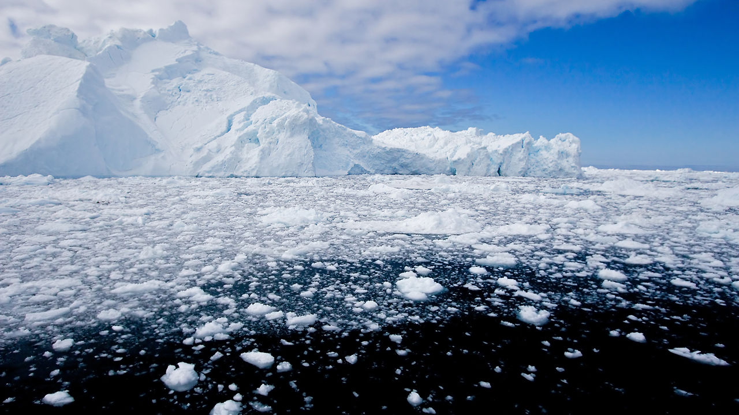

Slide 5
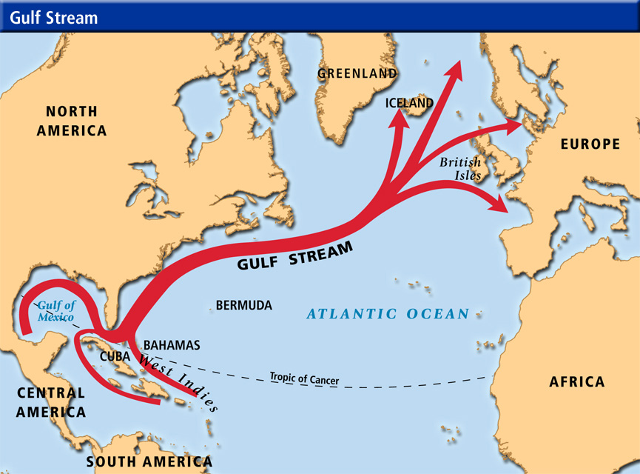

Slide 6
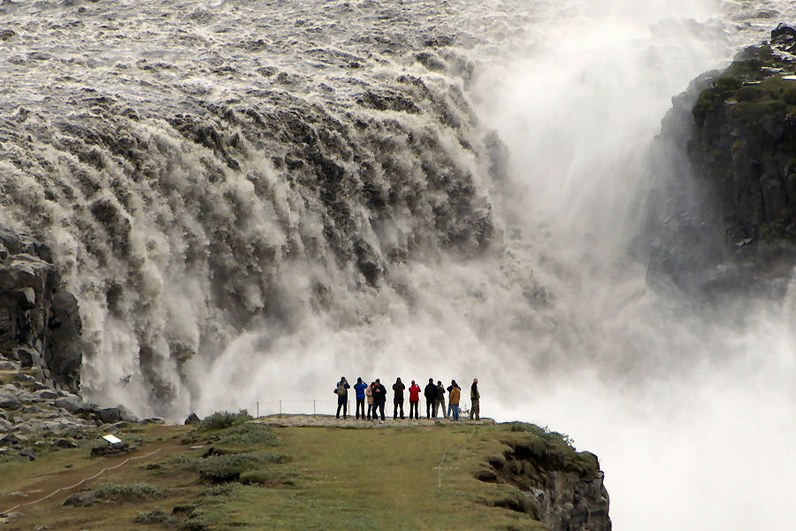

Slide 7
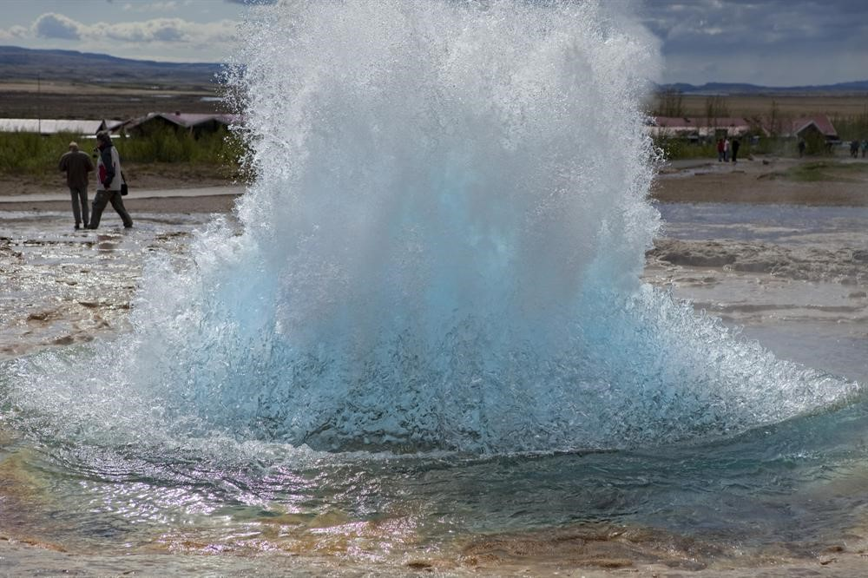

Slide 8
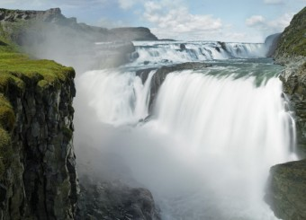

Slide 9
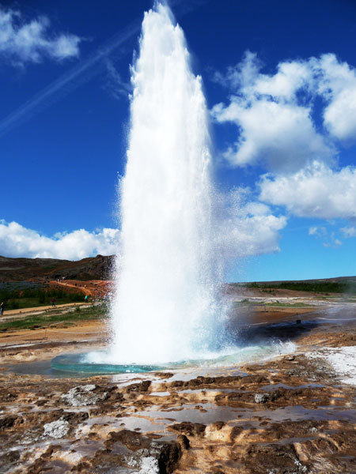

Slide 10
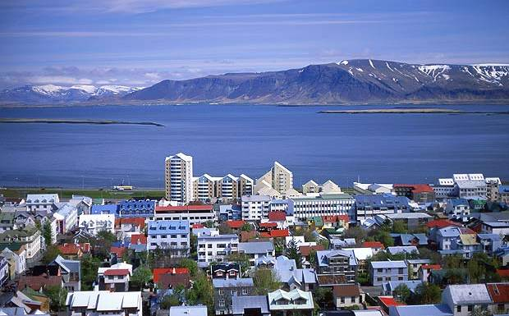

Slide 11
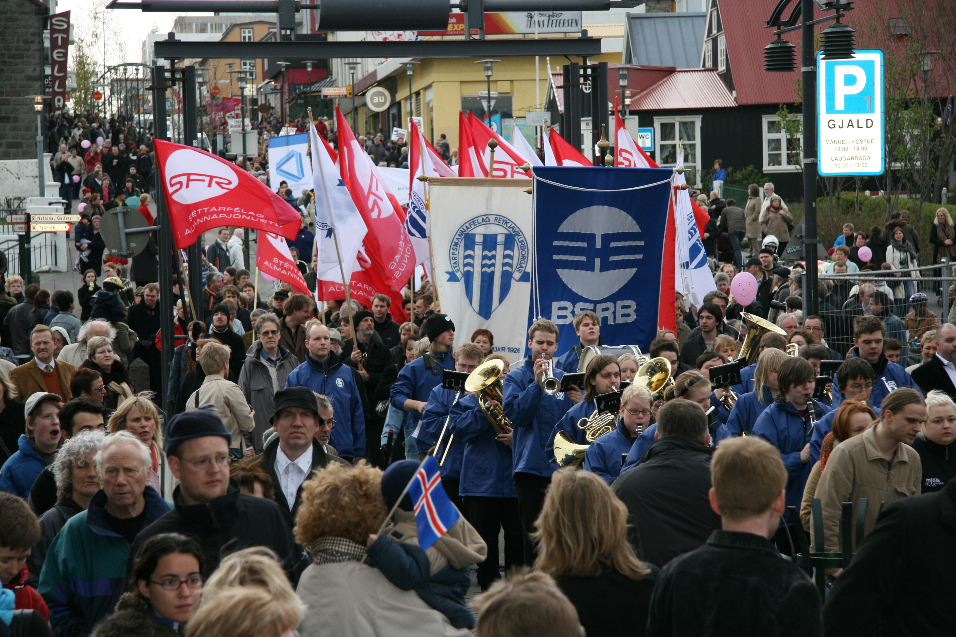

Slide 12
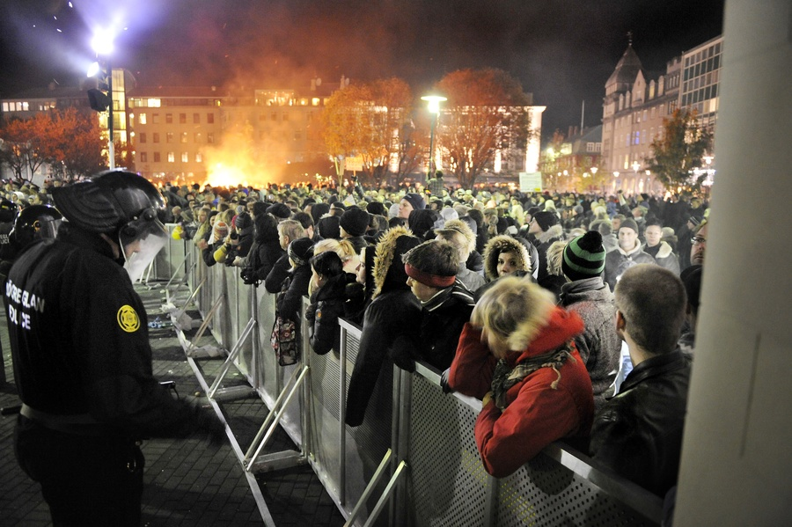

Slide 13
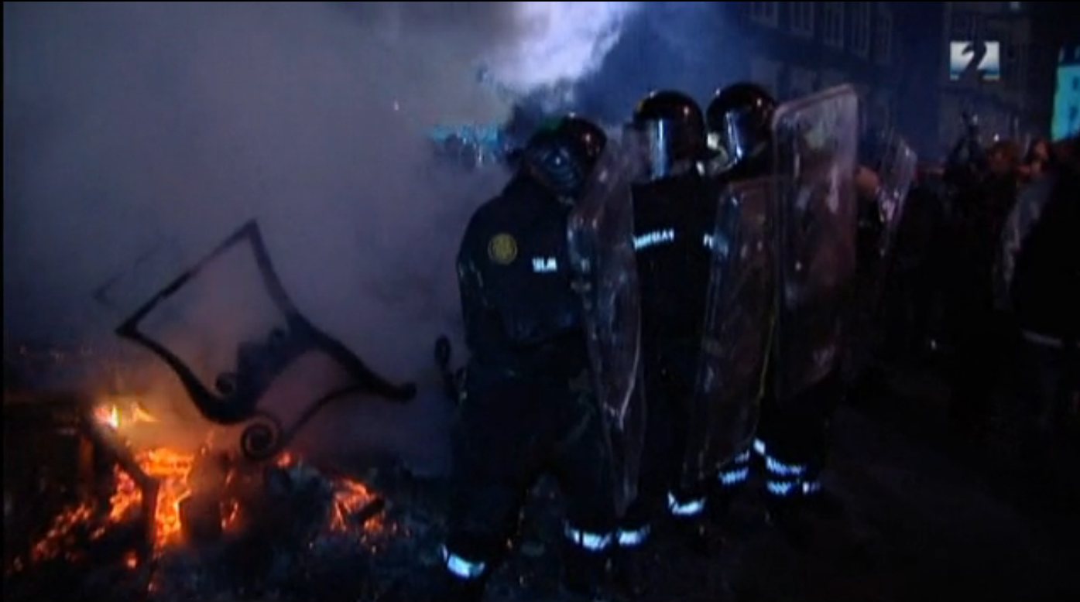

Slide 14
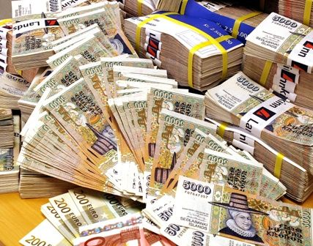

Slide 15
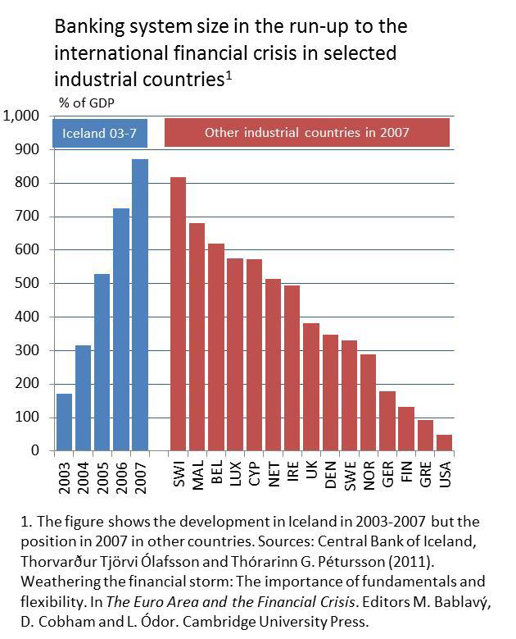
Expansion of the banking system
Rapid expansion of the banking system
2 times GDP in 2003 roughly 11 times GDP in 2008

Slide 16
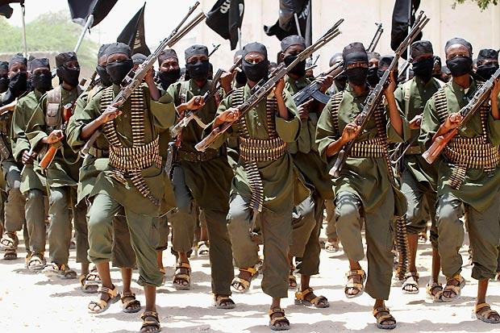
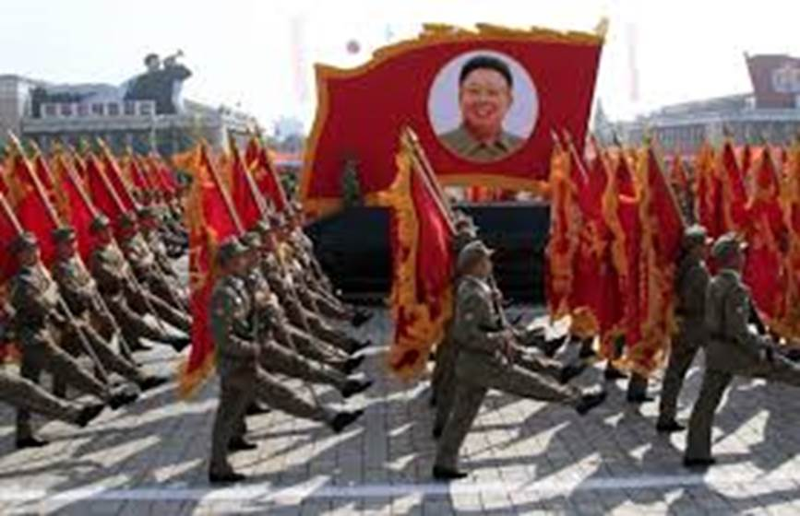
Anti-terrorism, Crime and Security Act invoked by British Government
October 8, 2008

Slide 17
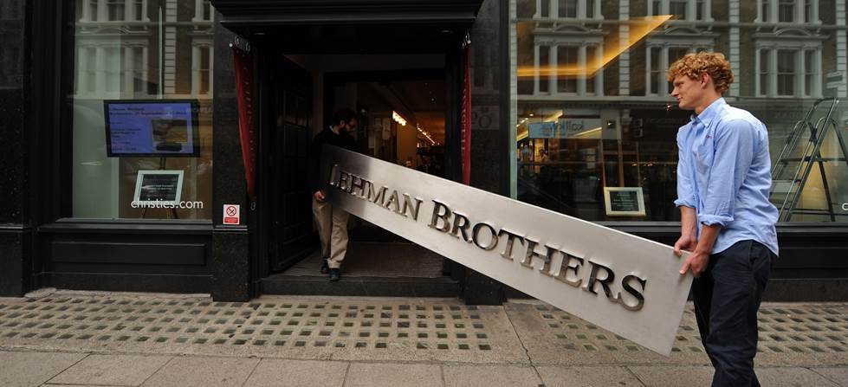

Slide 18
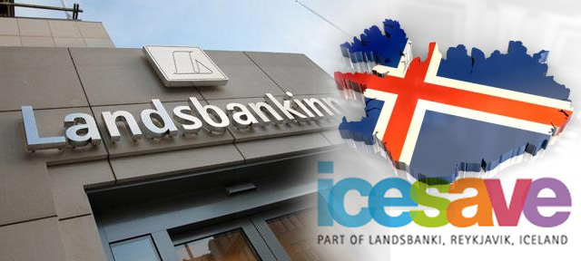

Slide 19
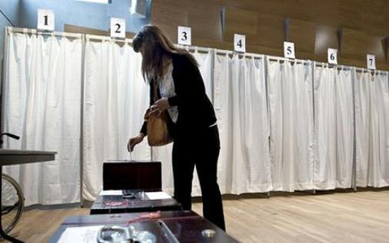

Slide 20
Unprecedented scale
Comparison with previous crises in relation to relative size of banking systems and to what extent they became insolvent

Slide 21
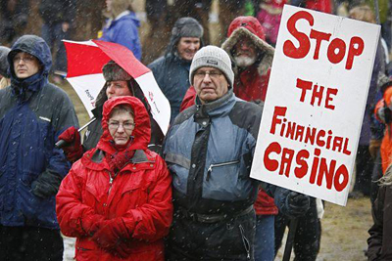

Slide 22
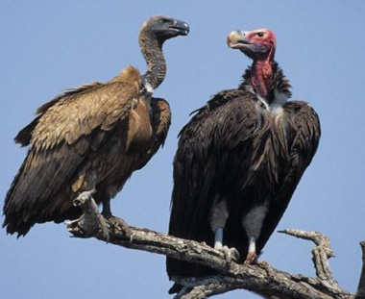

Slide 24
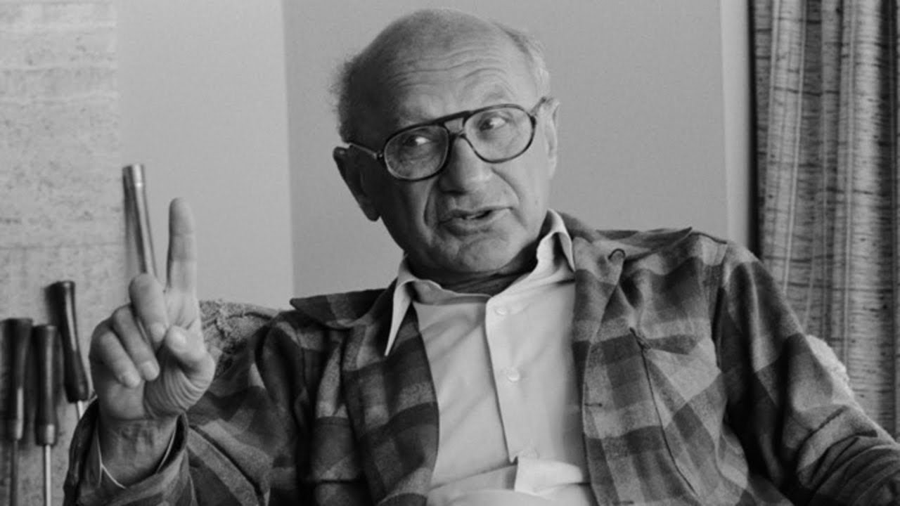

Slide 25
How the Crisis was tackled

Slide 26
Key Policies
Prevent socialization of private bank debt and risk
Shield the real economy from the financial crisis
Priority to deposits while bailing in bond holders
New domestic banks to guarantee a functioning monetary system
Capital controls to prevent capital flight
A goal set to balance the budget
Combination of higher taxes and cuts in expenditure

Slide 27
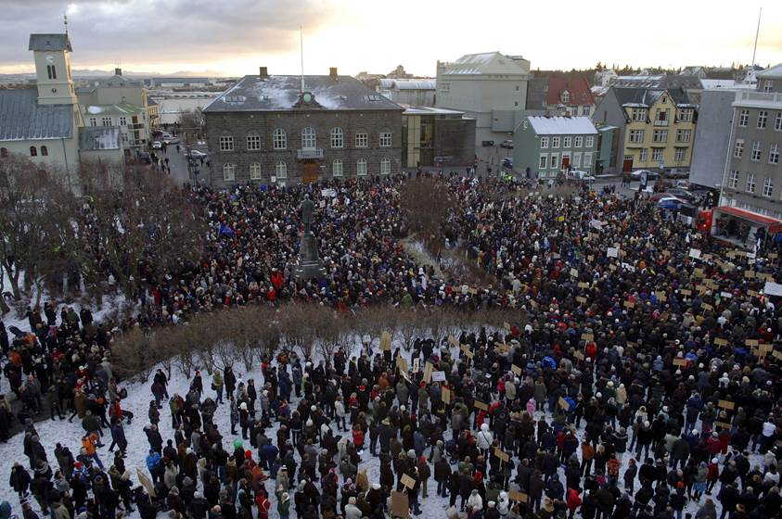

Slide 28
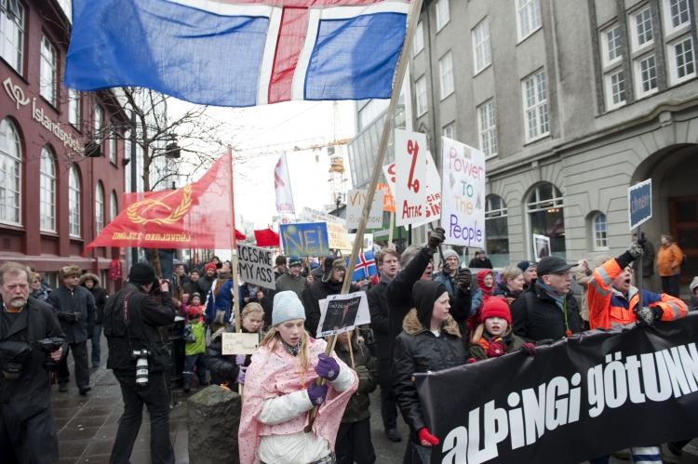

Slide 29
Debtors‘ Ombudsman
Founded 1. August 2010
Response to high demands to assist homes in debt crisis
State institution
Under the Ministry of Welfare
Funded by levying financial institutions

Slide 30
Number of applications

Slide 31
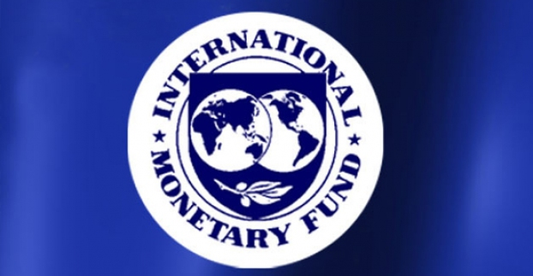

Slide 32
Unemployment - development by years and prospects

Slide 34
Budget cuts
Poportional budget cuts | 2009 | 2010 | 2011 | 2012 | total
Operating expenses | 8.4% | 7.0% | 5.5% | 2.3% | 23.2%
Transfer payments | 5.6% | 7.4% | 3.7% | 1.9% | 18.6%
Investments | 38.1% | 31.8% | 14.1% | 1.2% | 85.2%
Total | 12.1% | 12.2% | 5.2% | 2.1% | 31.6%T

Slide 35
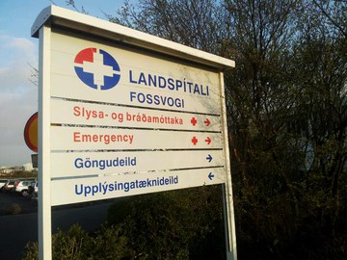

Slide 36
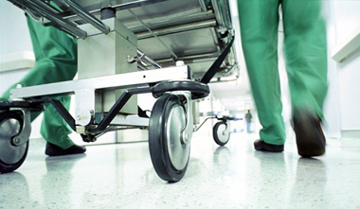

Slide 37
Accumulative increase in taxes and cuts 2009-2012
Tax increase | 2009 | 2010 | 2011 | 2012
% of GDP | 1.6 | 4.9 | 5.5 | 6.1
Budget cuts | 2009 | 2010 | 2011 | 2012
% of GDP | -2.6 | -6.1 | -7.5 | -8.0

Slide 38
Fiscal cost and increase in sovereign debt
Fiscal cost: Fiscal cost of the crisis 44% of GDP
Sovereign debt: Increase in debt by 72% of GDP
Source: IMF

Slide 39
Long-term benefits?

Slide 40
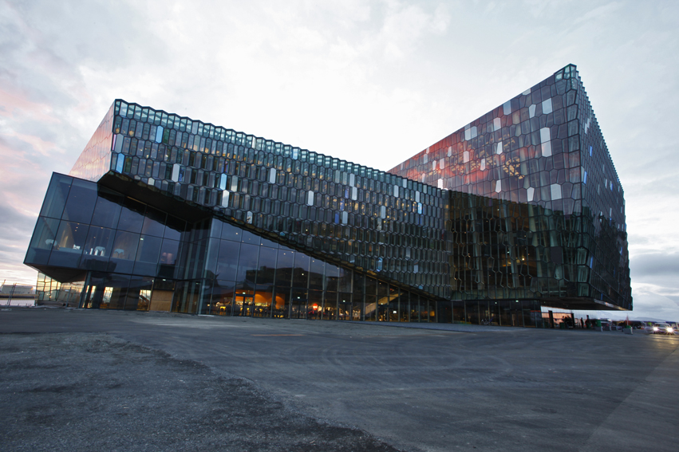

Slide 41
Anti-corruption measures

Slide 42
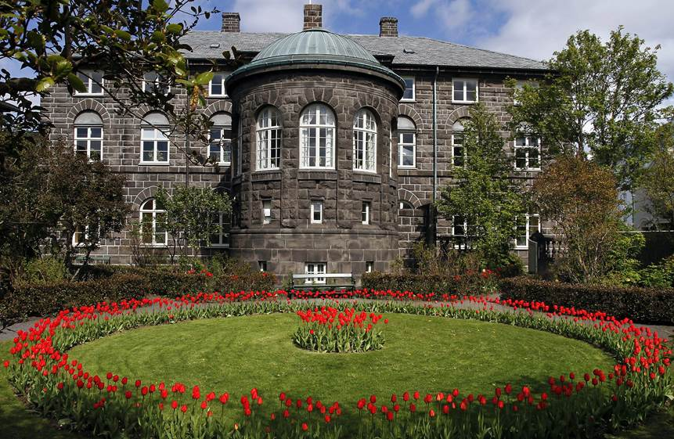

Slide 43
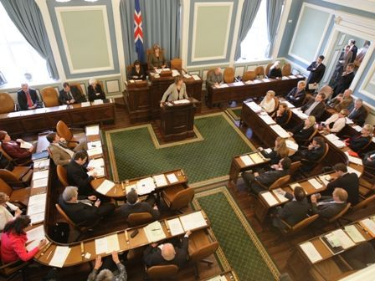

Slide 44
Office of Special Prosecutor established in 2009

Slide 45
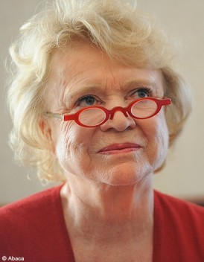

Slide 46
About 200 bank-collapsed cases have been handled by the Special Prosecutors Office.
23 indictments issued on basis of 32 investigation cases and in those cases about 70 individuals are being prosecuted.
Notes:
1. Current organisation.

Slide 47
Reimbursement

Slide 48
Plan for removal of capital controls
Failed estates (old banks) are the largest contributor to Iceland‘s balance of payment problem. They faced two options:
To make voluntary Stability Contribution to Treasury/Central Bank and fund the financial system for a long period.
Otherwise be subjected to a one-off Stability Tax of 39%
Currency auction for holders of offshore ISK

Slide 49
Iceland´s debt
 | 2003 | 2007 | 2015
external debt (%GDP) | 146 | 631 | 234
Government debt (%GDP) | 40 | 29 95 | 61

Slide 50
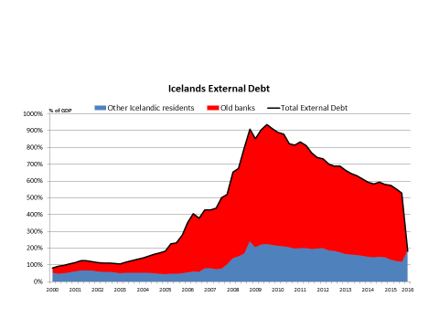

Slide 51
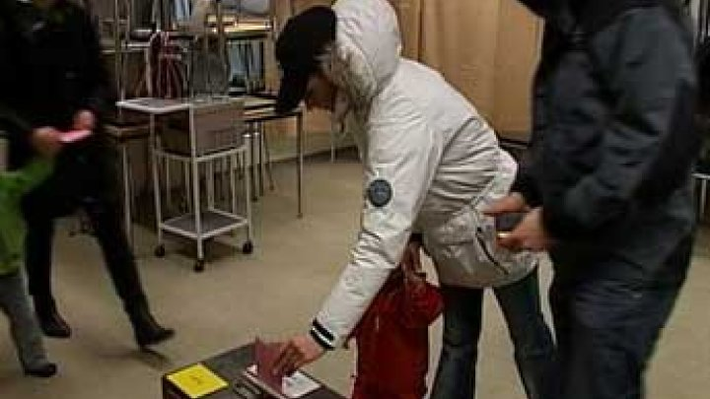

Slide 52
Lessons to be drawn The importance of social values

Slide 53
The key to success

Slide 54
