Slide 1
PSI Global Trade Work
IAMRECON
Health Sector

Slide 2
The new wave of trade agreements
Shift away from multilateral system
FTA’s proliferating – over 2000 since mid 90’s
Regional trade agreements expanding – new plurilaterals
Not transparent – secret, exclusive

Slide 3
Not about tariff’s
97% removal of non-agricultural tariff's
Investors rights
Regulatory coherence
Domestic regulation
Enforcement - Investor State Dispute Resolution procedures
Notes:
Increasingly about creating rights for MNE investors
Note this often gives them more rights than local companies

Slide 4
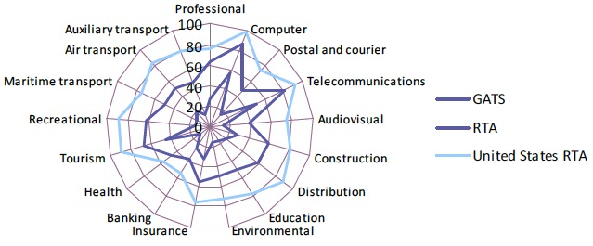
Developing Country Service Commitments:
Much greater in US FTAs than GATS
Source: UNCTAD 2014
Notes:
-

Slide 5
Democracy
Will bind future governments
Negotiations not disclosed to public – mandates, offers, text
Will stop governments from delivering services in accordance with mandate (auto insurance case)
Enforced with penalties - rare
Notes:
1 -More like constitution change than legal change
2 - People outraged if law was made like this locally
3 – flexible provision + future provision
ISDR
Private panels – can be a judge and a party at same time
Rights to investors to sue governments – unheard of
Australian tobacco and plain packaging example
Chill effect

Slide 6
Public Services are not commodities
QPS: Provide basic social and economic necessities universally on the basis of need. Exists because markets will not produce these outcomes.
Trade agreements: deliberately promote commercialisation and define goods and services in terms of their ability to be exploited for profit by global corporations and international service providers.
Notes:
Trade Agreements fundamentally misconceives public services and privilege the profits of the richest in the world over those who have the greatest need.

Slide 7
Trade Agreements Effect Public Services
Privatisation
Ability to regulate
Creates corporate rights that challenge state rights

Slide 8
Restrictions on public services
Standstill: confining public services within existing boundaries,
Dom regs: Restricting governments options for regulating
Ratchet: locking in future (failed) privatization and (failed) regulation
Negative list: Future services
Notes:
Future services:
Public services evolve.
Previously: public health systems, public transport systems, public education and public waste and sanitation in many countries.
Future policy challenges such as medicine and biotechnology, climate change related energy and abatement measures, banking re-regulation or internet regulation are likely to require some form off public sector involvement.

Slide 9
Beyond Non-Discrimination
GATS prohibits public monopolies and exclusive service suppliers in committed sectors.
Governments cannot restrict or require “specific types of legal entities” through which to supply services.
applying ‘pro-competitive’ regulation to previously socialized services
Notes:
Normal areas of agreement is to stop government discriminating against foreign providers
But GATS goes further
For example, GATS Article XVI prohibits public monopolies and exclusive service suppliers in fully committed sectors, even on a regional or local level.
ALSO: cant restrict legal form of service providers in fully committed sectors (such as favouring community-based not-for-profits) which are so important in social services, child care, and education.
The GATS also develops templates for pro-competitive regulation, tailored to certain sectors such as telecoms.

Slide 10
Insufficient carve-out for public services
GATS excludes services provided “in the exercise of governmental authority.”
defined as “any service which is supplied neither on a commercial basis nor in competition with one or more service suppliers.”
Notes:
If left to governments to define would not be problem
But defined very narrowly
Major problem with “in competition with one or more service suppliers”
most public service systems involve a tightly regulated mix of - public, not-for-profit, and private - financing and delivery.
Recent interpretation shows only safe areas are (police and judiciary, prisons, statutory social security schemes, border security, air traffic control, etc.), which are currently of no commercial interest (EC reflections papwer 2011)

Slide 11
Domestic regulation
Binding rules that allow corporations to challenge new or costly regulations – even if domestic and foreign treated the same
Covers qualification requirements, technical standards and licensing requirements
Worker safety, environmental, consumer protection, universal service obligations, water standards, municipal zoning, toxic waste transport, educational institutions etc
Notes:
Quals – professional and trade standards
Tech standrads – rules according to which the service must be performed + tech standards – rules about how patient care must be carried out OR how equipment is to be operated
Licensing requirements – professional licencing but also related to governments permission to companies to provides services ie licencing health facilities and laboratories, waste disposal, broadcast licenses, power plants

Slide 13
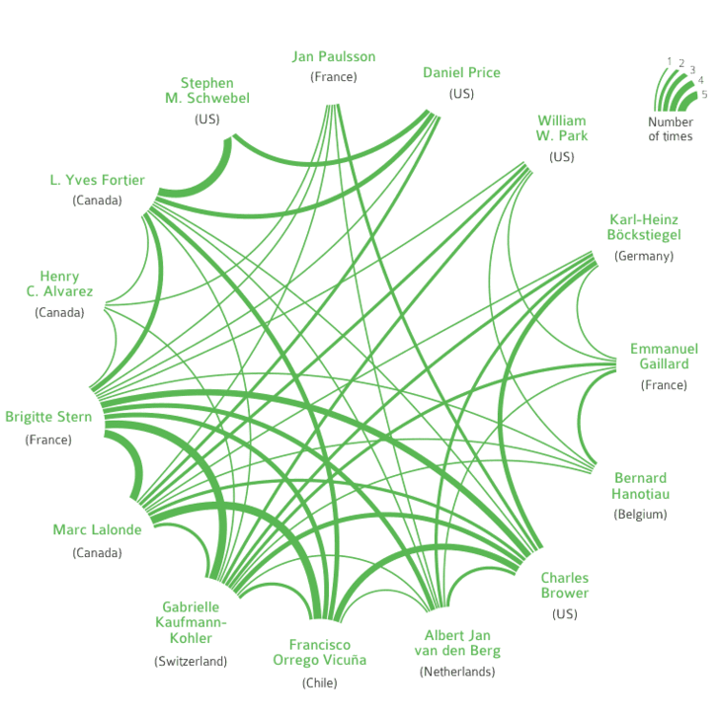
15 arbitrators alone have captured the decision-making in 55% of the total investor-state cases known today
Private, unaccountable, no appeals, no conflict of interest rules
Winning gov’t compensation
or
preemptively chilling government actions,
Source: Profiting from Injustice http://corporateeurope.org/publications/profiting-from-injustice

Slide 14
Some of the Investor-State Cases
Attack on Reversal of Water System Privatization
Vivendi v. Argentina: 2007 (France-Argentina BIT). Argentina ordered to pay $105M to firm that cut off water to Buenos Aries. Contract dispute over U.S. $$-denominated rate guarantees unpayable in financial crisis.
Attack on Post-revolution Increase in Egypt’s Minimum Wage
Veolia vs Egypt: June 2012 (France-Egypt BIT). The company argues that changes to local labor laws – including recent increases in minimum wages – have impacted negatively on the company despite contract provisions designed to buffer the concessionaire from the financial implications of any such legal changes.
Attack on South Africa’s Black Economic Empowerment Policy
Piero Foresti & Others v. South Africa: Mining investors claim South Africa’s Black Economic Empowerment law violated investment treaties even though it implemented new South African constitution post-Apartheid.
Attack on Canadian medicine patent policy by Eli Lilly
$500M claim because Canadian high court invalidated patents on 2 drugs that didn’t perform as filed
Attack on Canadian Toxic Chemical Ban
Ethyl v. Canada – ban reversed, corp. paid $13M for lost profits while ban was in effect – US states ban same chemical, MMT a gasoline additive
Attack on Australian, Uruguayan Cigarette Health Laws by Phillip Morris
Chevron Attacks Ecuador to halt court-ordered payment for Amazon pollution

Slide 15
PSI Work
TTIP
TTP
TISA
And how it effects the fight for universal health

Slide 16
Why a TISA?
Services Sector growth
2/3 of GDP but 20% of trade
Doha round at a standstill
GATS incomplete – TISA extends GATS
Aim to pressure other countries to join after conclusion
Notes:
Corporate lobbying – especially in America – Services Industries Association

Slide 17
Who does it cover?
Canada, Chili, Colombia, Costa Rica, Mexico, Panama, Peru, United States
Australia, Hong Kong, Japan, New Zealand, Pakistan, South Korea, Taiwan
Iceland, Norway, Switzerland, 28 members of the EU
Turkey, Israel
60% of worlds services
Notes:
Really Good Friends of Services
Gold standard
Large coverage of world economy
Forcing countries to join after it has been negotiated
China is latest country to announce joining talks – quite significant

Slide 18
History of TISA
Started in early 2013
Secret negotiations in Geneva every 8 weeks
Extension of GATS
Heavily lobbied for by USA Coalition of Service Industries

Slide 19
Characteristics
Deeper commitments (>90% coverage?)
Standstill and ratchet clauses (privatisation)
Negative list on national treatment (future services)
Domestic regulation (broad as above)
Not releasing texts, mandates or brackets
Notes:
Opposed by many developing countries – South Africa

Slide 20
Who wants the TISA?
The Global Services Coalition in a letter to the European Commission explains that the TISA was conceived:
“to allay business frustration over the stalled Doha Round outcomes on services.” (September 10, 2013).
Notes:
http://www.esf.be/new/wp-content/uploads/2013/10/GSC-Letter-on-TISA-to-Karel-de-Gucht1.pdf

Slide 21
The US Coalition of Service Industries (CSI) set up a TeamTISA to promote TISA
Microsoft
JP Morgan Chase
CHUBB
Deloitte
UPS
Google
Verizon
Walmart
Walt Disney
IBM
and more.

Slide 22
Who else?
Financial Services text from Wikileaks shows that the following organisations support the TISA:
US Securities Industry and Financial Markets Association
US Chamber of Commerce
Canadian Services Coalition
Coalición Mexicana de Servicios
American Insurance Association
VISA
Bloomberg Financial information Services

Slide 23
What do they want?
Walmart in its submissions to the US Trade Representative (USTR) sees the TISA as a way to free itself of restrictions on the sale of pharmaceuticals, medical devices, alcohol and tobacco and avoid zoning laws
FEDEX in its submissions to the USTR seeks the elimination of “regulatory advantages historically conferred on national post offices”. In other words it sees the TISA as a way to force the deregulation of the postal system.
Notes:
http://www.teamtisa.org/
http://www.teamtisa.org/index.php/about-team-tisa/coalition-members
http://wikileaks.org/tisa-financial/
Testimony, Walmart, “Walmart ISA Comments 2013”, response to USTR “Request For Comments On An International Services Agreement” Docket Number: USTR–2013–0001. Online at: http://www.regulations.gov/#!documentDetail;D=USTR-2013-0001-0028
FedEx, response to USTR “Request For Comments On An International Services Agreement” Docket Number: USTR–2013–0001. 25 February, 2013. Online at: http://www.regulations.gov/#!documentDetail;D=USTR-2013-0001-0007

Slide 24
What services does it cover?
cross border services (GATS Mode 1), Telemedicine, online health services, online drug purchases;
consumption abroad (GATS Mode 2) medical tourism;
foreign direct investment (GATS Mode 3) multinational corporations buying or establishing private hospitals, clinics, laboratories etc
temporary movement of persons (GATS Mode 4) such as nurses, doctors, personal carers, health executives temporarily travel abroad to provide services.
Notes:
Only 1 mode is actually about trade in services – MODE 1

Slide 25
What provisions does it cover?
Necessity test
Cross subsidies
Decision making cant involve undue delays
Licensing
Notes:
Necessity test – not more burdensome than needs to be – political reality of making laws
Cross subsidies – cant use postal system to subsidise distance services
Subjectivity and planning – heritage, set back, colours, style
Licensing – can only cover the cost of the issuing and enforcement – gambling and addiction treatment

Slide 26
Trans-Pacific Partnership (TPP)
Notes:
As you can see there is a mixture of developed and developing nations involved in the TPP

Slide 27
Notes:
US companies, some of whom have access to the text of the negotiations, are lobbying hard for the TPP.
This graph, from the Sunlight Organisation, shows that the US pharma are the biggest lobbyists by far

Slide 28
Effects on Health System
Delayed access to generics by patent extension to 20 years and 5 years for changes (ever-greening) i.e. delivery, indications
Health technology & procedures (IP)
Harder to negotiate lower prices for medicines (transparency annex)

Slide 29
TPP – Effects on public health
Food labelling (technical barriers)
Public health policy - Plain packaging (IP) & alcohol (market access)
ISDS – squeeze budgets

Slide 30
And some more…….
State owned enterprises and foreign competition (subsidies)
Government procurement – local purchasing
Regulatory coherence – greater role for industry in policy making

Slide 31
Over-reach: Mood is changing
AFL-CIO
ETUC
TUC
DGB
Civil Society
Washington Forum
TISA Forum

Slide 32
We are winning
China and ‘set the standards’ rhetoric
Labour clauses
Appropriateness
Enforceability
Vietnam and Ecuador examples

Slide 33
What to do?
Understand how the agreements effect your members
Understand how they effect workers and democracy
Explain more than tariffs and trade
Work with civil society allies
Reach out to private sector unions
Influence your national centre
Lobby your government

